Slide 1

HEALTHDATA
IT Info Session
15th May 2023
This meeting is recorded for purposes of meeting minutes, delayed viewing by absentees, and internal (HD) knowledge transfer. The recording will be available for download for a limited time period after this session..
Update: 15/05/2023
Notes:
Hello everyone!
Hopefully, you’ve had a very pleasant weekend.
I’m happy to welcome you to our IT Info Session aimed at IT staff of hospitals.
Joining me on presentation duties are Kurt Vanbrabant and Jolien Vervinckt. In addition to them there are a number of colleagues on this call who’ll help answer any questions that you might have.
I have a few items of, let’s say ‘housekeeping’, which I would like to cover before we move onto the agenda for today’s session.
First of all, could you please ensure that you are muted?
Secondly, if you have any questions during the presentations we kindly request that you ask them via the Q&A panel in this webex. Myself and other colleagues will aim to answer them as they appear. Using the Q&A panel (instead of the chat) will allow us to easily copy & paste everything to a word or excel document which will then be sent to all attendees.
Thirdly, this meeting is recorded, and as with the Q&A, you’ll all receive a copy of it later on.
Right, now that I’ve covered basic admin, I think we can dive directly into the agenda for today.

Slide 2
Introduction
Online Acceptance Environment
Technical Documentation
User Accounts/EAM
In The Pipeline…. q&a
Q&A
AGENDA
Notes:
Before we cover the main topics, it’s best that I provide a brief introduction…essentially explaining why we are all here.
After this, Kurt will be showcasing our new online acceptance environment which many of you have been requesting. This is accompanied by a demo which will really give you a great insight into new feature.
Once he’s covered the online acceptance environment topic, Kurt will be giving you a status update on Technical documentation, also accompanied by a short demo.
At this stage, we’ll have a short break of 5 minutes so you can stretch your legs, grab a coffee or tea…
Following this, Jolien and I shall be discussing User Accounts and our plans for the EAM portal.
Last up, a couple of ‘in the pipeline’ topics shall be shared with you
Having completed the last topic, we’ll open up the floor for any outstanding questions that you might still have. Just raise your hand and unmute yourself
Right….let’s get started….

Slide 3
Introduction
Online Acceptance Environment
Technical Documentation
User Accounts/EAM
In The Pipeline…. q&a

Slide 4
Introduction
Commonly reported issues affecting/impacting most hospitals
Technical Documentation → Incomplete or incorrect
Online Acceptance Environment → Missing
User Access / EAM → Diverse issues
Healthdata is working hard to address all these topics…and we are making solid progress
Notes:
What bring us here today is the fact that many of you have been reporting a number of issues which can be grouped into 3 main topics as you can see on this slide. These concerns were escalated to RIZIV, who turned to us for answers. The result of this is today’s session.
Technical documentation is a problem – broadly speaking, you have identified the fact that numerous projects just don’t have complete or appropriate files available in the docs pages.
Another hot topic is the lack of an online environment where testing of csv and api uploads can occur. Hospitals would really appreciate being able to do some test uploads to ensure that everything’s been properly set up.
Lastly, a significant number of hospitals have been impacted by user account issues over the past few months. This had a variety of different effects, such as password links expiring, users being duplicated, author groups being inexplicably deleted, to name a few.
We fully recognize the seriousness of the situation, the impact it’s had on your ability to conduct your work and the growing frustration that it’s caused.
Today’s info session will hopefully show you that healthdata is indeed listening to all your concerns and actively working to address them.
While all issues haven’t been resolved yet, we are clearly making tangible progress …as we continue to listen to your feedback in order to implement necessary changes and upgrades.
The end goal is to generate a fruitful working relationship with you all by ensuring that user experience is optimised.
So, there you have it, our introduction to today’s session…
It’s at this stage that I shall pass the mic onto Kurt.
Kurt…all yours

Slide 5
Introduction
Online Acceptance Environment
Technical Documentation
User Accounts/EAM
In The Pipeline….
Q&A

Slide 6
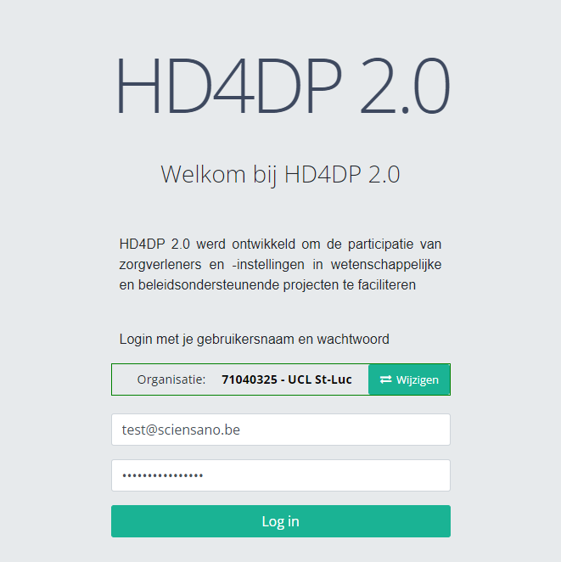
Online Acceptance Environment : Front end application

Slide 7
Online Acceptance Environment
Types of data transfers that can be tested:
API | CSV | Form Entry
Via an API platform. E.g. Postman | Via a SFTP client. E.g. WinSCP | Via a browser. E.g. Google Chrome Can also be used to validate data sent via API or CSV.

Slide 8
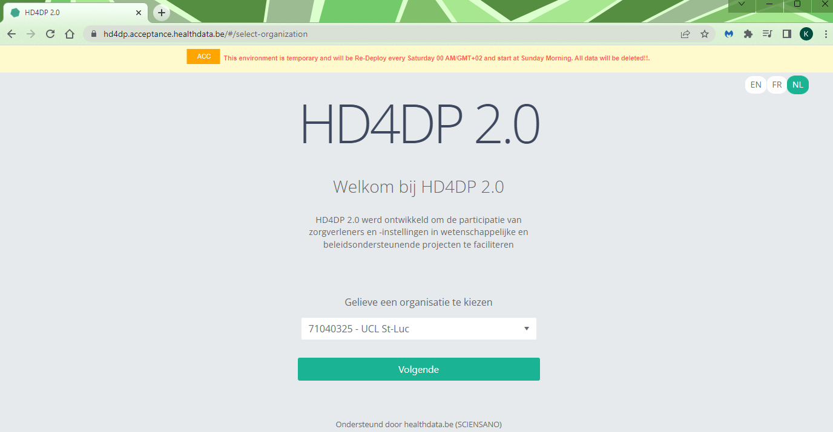
Online Acceptance Environment : Front end application
https://hd4dp.acceptance.healthdata.be/
Data is stored locally and not sent to healthdata.be.
Limited list.
If your organisation is not yet in the list, please request access via our support portal.

Slide 9
Online Acceptance Environment : Front end application
username: test@sciensano.be
password: upon request

Slide 10
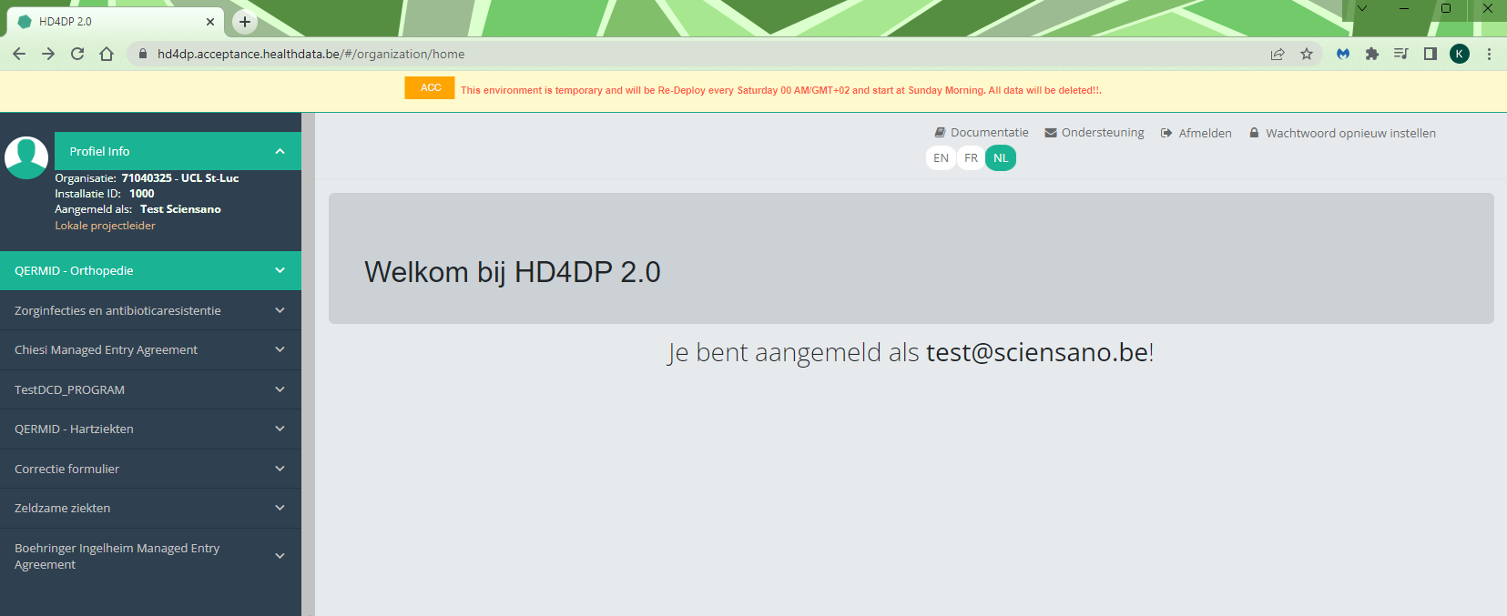
Online Acceptance Environment : Front end application

Slide 11
Online Acceptance Environment : API
The endpoint to send the payload:
https://hd4dp.acceptance.healthdata.be/proxy/api/dcd/payload/submit?organization-id=00&dcd-id=00&version=1
Credentials:
type: Basic Auth
user: sciensano
pass: upon request
Demo API using Postman
Additional information:
https://docs.healthdata.be/documentation/hd4dp-v2-health-data-data-providers/hd4dp-v2-s2s-api

Slide 12
Online Acceptance Environment : CSV
SFTP connection:
sftp.acceptance.healthdata.be
port 2220
Credentials:
user: organisation-<id> e.g. organization-6
pass: upon request
Demo CSV using WinSCP
Additional information:
https://docs.healthdata.be/documentation/hd4dp-v2-health-data-data-providers/hd4dp-v2-csv-upload

Slide 13

Q & A

Slide 14
Introduction
Online Acceptance Environment
Technical Documentation
User Accounts/EAM
In The Pipeline….
Q&A

Slide 15
Technical Documentation
DOCS | FAIR
https://docs.healthdata.be Application documentation Data collection projects user documentation | https://fair.healthdata.be/ Data collection projects descriptions Dataset descriptions (XLSForms, …) Sample files: CSV, submission json, form json, …

Slide 16
Technical Documentation : updates
Project | CSV example full | CSV header | Submission JSON | DCD spec
Spine Surgery | 13/04/23 | 14/04/23 | 14/04/23 | 14/04/23
Orthopride Knee | 19/04/23 | 19/04/23 | 19/04/23 | 28/04/23
Orthopride Hip | 24/04/23 | 24/04/23 | 24/04/23 | 28/04/23
Orthopride Femur | 27/04/23 | 27/04/23 | 27/04/23 | 28/04/23
Pacemaker | 05/05/23 | 05/05/23 | 05/05/23 | 21/04/23
Coronary Angioplasty | 12/05/23 | 12/05/23 | 12/05/23 | 21/04/23
Heart Valves | 16/05/23 | 16/05/23 | 16/05/23 | 14/04/23
Zephyr | 25/05/23 | 25/05/23 | 25/05/23 | 21/04/23
R-PROFILD | 29/05/23 | 29/05/23 | 29/05/23 | 21/04/23

Slide 17
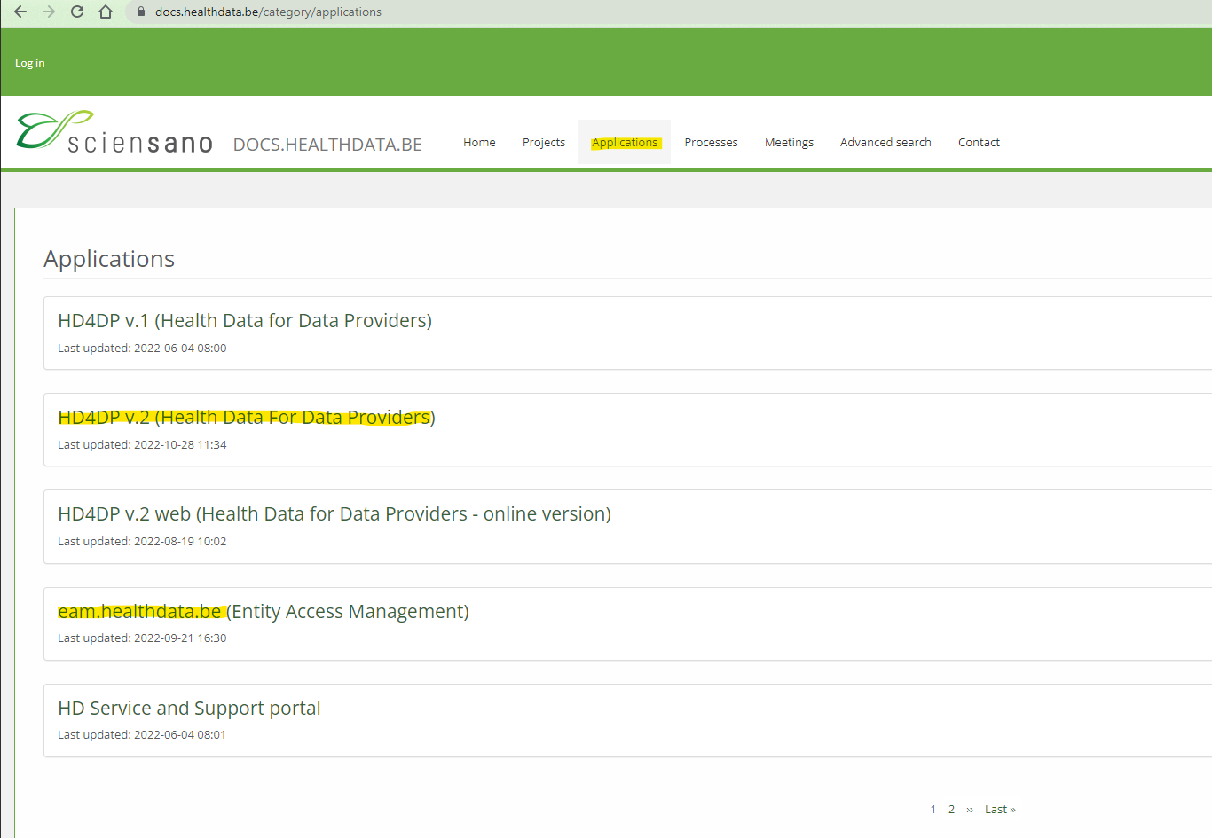
Technical Documentation : https://docs.healthdata.be
https://docs.healthdata.be
Demo on docs

Slide 18
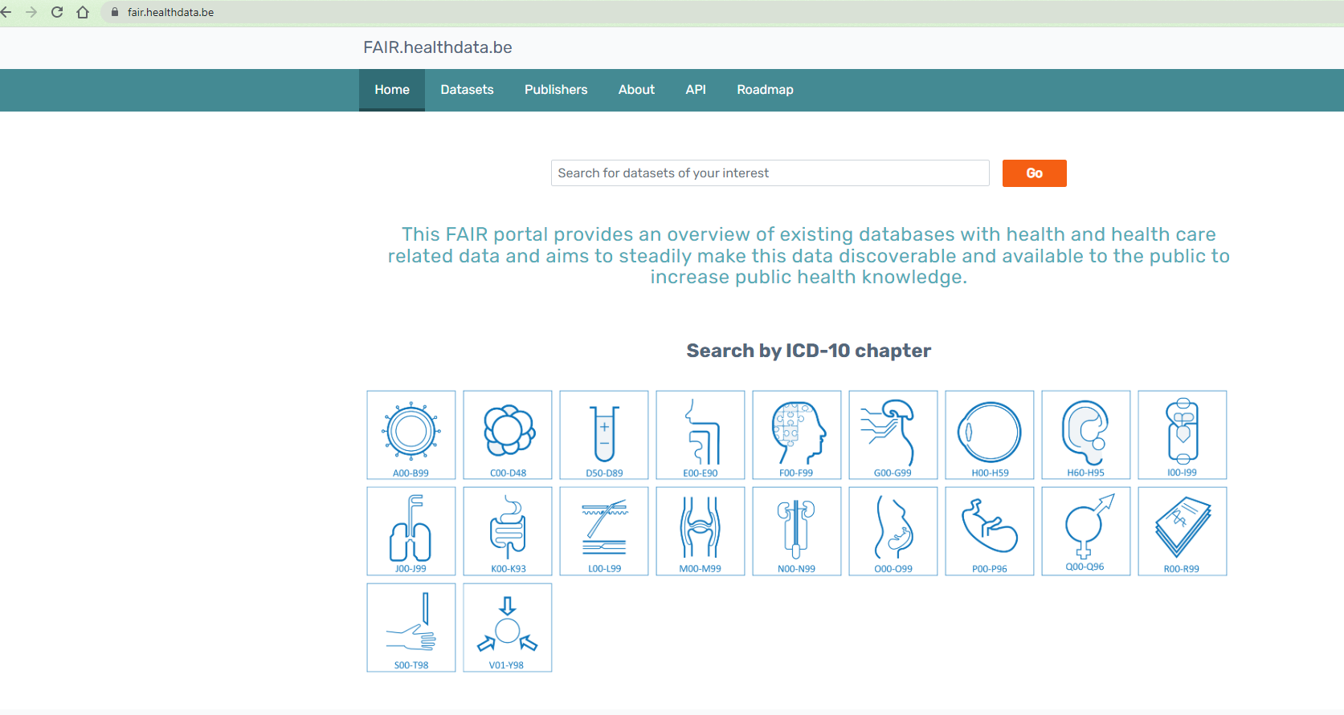
Technical Documentation : https://fair.healthdata.be
https://fair.healthdata.be
Demo on Fair

Slide 19
Coffee/Tea Break – 5 mins
Please send us your contact details (name, organization & email address so that we can ensure our distribution list is as up-to-date as possible)
Don’t share this via chat, but send an email to our onboarding mailbox:
onboarding.healthdata@sciensano.be
THANK YOU!!!!

Slide 20
Q & A

Slide 21
Introduction
Online Acceptance Environment
Technical Documentation
User Accounts/EAM
In The Pipeline….
Q&A

Slide 22
User Accounts
Most common issues/questions on user creation
Author group issues:
Author group empty
Requested author group not present in HD4DP2
Login credentials not working:
Role change
Password reset
Resending of credentials (due to expired password link)

Slide 23
EAM
Initial Scope – to capture users only and not designed for user management
Updated Scope – integrate user management capabilities
Internal Impact:
Substantial involvement from our operations team required to solve each issue
Client Impact:
Time lost while the issue is fixed
Potential accumulation of registrations to handle
Solution:
Change underlying software
Notes:
It’s important to note that the initial scope of the tool was to capture users only. Based on the feedback we have received from hospitals….we have decided to make it more into a user management offering, which caters to users’ needs as well as putting more power in their hands.
At any rate, the current system we have in place needs changing. As things stand, our operations team is spending a very significant amount of resources in resolving the flow of tickets that have been logged via the service desk. Unfortunately, addressing these on a case by case basis takes time. As a consequence, a backlog has developed.
For the end users, it represents a big hurdle …time lost while awaiting resolution and subsequently more work to catch up on
We’re fully aware of the frustration that this is causing all of you and we really want to make it right.
We have decided to replace the current software underpinning the EAM portal with an alternative one which better suits the needs of the end users.
This new tool boasts a number of improvements which I shall cover in the following slide

Slide 24
EAM
Technical Benefits | Business Benefits
Scalability | Interactive Feedback
Reliability | Faster User Onboarding
Security | Better User Experience
Integration | Enhanced Collaboration
Improved Efficiency
Notes:
Scalability: This is a highly scalable solution that can handle a large number of user management tasks without impacting performance. This ensures that the system can grow with the organization's needs.
Reliability: It also provides reliable messaging services, ensuring that user management tasks are executed accurately and reliably.
Security: Supports various security features such as encryption and authentication, reducing the risk of unauthorized access or data breaches. This can help protect sensitive user information.
Integration: Azure Service Bus can easily integrate with other Azure services or third-party systems, making it easier to extend the user management system's capabilities in the future.
Improved Efficiency: With the implementation of Azure Service Bus, the user management process will be more streamlined, reducing the need for manual intervention from the support or DevOps team
Business (Use-case) benefits:
Interactive Feedback: EAM can obtain operation statuses, eliminating the need for Operations to log in and manually validate issues, thereby reducing the resolution time an end user needs to wait before being able to continue their work
Faster User Onboarding: The proposal allows for quicker user creation and assignment to projects, which can lead to a more efficient onboarding process.
Better User Experience: Offering features like password reset without needing to know the existing password can provide a better user experience and reduce support requests.
Enhanced Collaboration: Using a feedback loop for user creation and validation can improve communication between different teams, leading to better collaboration and faster issue resolution, ultimately positively impacting the end user.

Slide 25
Q & A

Slide 26
Introduction
Online Acceptance Environment
Technical Documentation
User Accounts/EAM
In The Pipeline….
Q&A

Slide 27
In The Pipeline….
Regular Info Sessions & MyCareNet
When?
Weekly/bi-weekly (to be determined) via webex
Why?
Because we want to listen to your needs and concerns
What?
Discussing critical service desk tickets
Topics determined by the audience ahead of each session
Crucial updates relating to tools and applications
MyCareNet
Soon to be finalized
You can address your questions to: qermid@riziv-inami.fgov.be
Change of process
Notes:
IT Info Sessions
MyCareNet
Despite technical implementation already being finished, a business acceptance needs to be conducted, which means that this is still in the pipeline.
When it comes to questions, you can send them to the general Qermid mailbox. It’s worth noting that some technical queries should still come to Healthdata, such as when you would like to install the automatic flow with the p12 certificate on our side.
Lastly, I would like to mention the following: change in process of sending the files: only 1 file is sent to MyCareNet per day, to limit the amount of messages. All MyCareNet messages will be aggregated into 1 file before sending.

Slide 28
Q & A

