Slide 1
Date Warehouse @ Sciensano
A high level overview

Slide 2
General
General Information

Slide 3
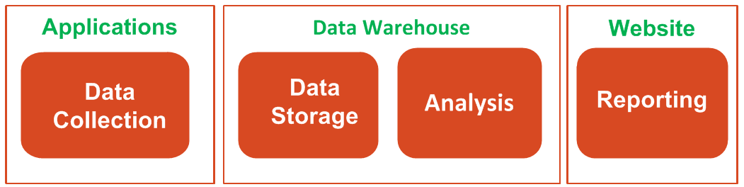
High level flow
The HealthData program consists of 3 major parts:
Applications for data collection. Some of these applications are managed by HealthData (HD4DP and HD4RES:), others are not. These others can consist of another DWH, a data collection application managed by another organisation that sends data ALSO to HealthData or an extraction from an authentic source (like MZG or RijksRegister).
Data Warehouse (DWH): secure storage of data for validation, analysis and ad hoc reporting
Reports: standardised reporting via the website, via extraction of files that have to be sent to a third party or any other reporting that has to be done.

Slide 4
Technical facilitator
No statistical analysis functional validation of data is done by members of Healthdata.
The ‘data collection manager’ is responsible for the quality of the stored data.
Every researcher is responsible for the correctness of his analysis and the validity of his reporting.
Healthdata has to make sure
the validated and non validated data are available
the data that can be used to reproduce the analysis and reporting are available
the technical authorization rules are implemented based on functional authorization rules managed by the data collection responsible.

Slide 5
Data Quality Control
Validating data

Slide 6


Data Quality Control
HD4DP
HD4RES
Data Warehouse via SAS eGuide
Healthstat.be
0. Registration in Primary System
1. Data Capture
2. Secure Data Transfer
2. Data Monitoring
3. Data Quality Control
4. Data Storage
5. Analysis
6. Reporting
Annotation & Correction Request
© WIV-ISP – healthdata.be

Slide 7
Data Quality Control
Illustration with 4 new incoming records for an existing register
SAS ETL
SAS eGuide
HD4RES
CDW
Pre-checks
Analysis
Validation
3 Different types of checks:
1) Within a record
Semantic checks: right format per field? E.g. subject name does not contain numbers
Logical checks: combinations of values and/or acceptable range of parameters e.g. age should be between 0 and 130 years
2) Cross-sectional checks: statistical outlyers
3) Longitudinal checks: are new results in line with historical data about same subject? E.g. previously length was 1m57, now length is 1m75
Flagging records based on automatic checks
1
2
3
4

Slide 8
Data Quality Control
Illustration with 4 new incoming records for an existing register
SAS ETL
SAS eGuide
CDW
HD4RES
Pre-checks
Analysis
Validation
Flagging records based on automatic checks
Researcher analyzes new records by comparing with existing records within register
Researcher accepts or rejects flagged records and can reject additional records.
1
1
1
2
2
2
3
3
3
4
4
4
Existing records

Slide 9
Data Warehouse Layers
Different levels of data storage

Slide 10
Data Warehouse Layers
DWH
Staging
Source Data
Pre-checks
Corporate Data Warehouse
Data model for building history
Dimensional model
View on data taking into account
SCRA (Small Cell Risk Analysis)
Exploration
Analysis & Reporting
External
Reporting via HealthStat.be
Aggregated data!

Slide 11
DWH Validation
Checking data content

Slide 12
DWH Validation
DWH
Staging
Data Validation
Corporate Data Warehouse
Dimensional model
Exploration
External

Slide 13
STG Flow Control Flags
FL_ERROR | 0 | 1 Indicates if an error (= possible data quality issue) is detected during the pre-checks.
FL_VALID_BY_RES | . | 0 | 1 Indicates if the record has been validated by the researcher. . (missing) : not yet validated 0 : record is not valid and will not be loaded further in the DWH 1 : record is valid and will be loaded in the DWH
FL_PROCESSED | 0 | 1 Indicates if the record is processed for further loading into the CDW layer
Important: When a record has not been validated , meaning the FL_VALID_BY_RES flag is left missing,
→ The record will be considered as valid and will be loaded further into the DWH.

Slide 14
DWH Validation
DWH
FL_ERROR | FL_VALID_BY_RES | FL_PROCESSED
1 / 0 | . | 0
Staging
Corporate Data Warehouse
Data Validation
FL_ERROR | FL_VALID_BY_RES | FL_PROCESSED
1 / 0 | 1/0 | 0
Dimensional model
Exploration
External

Slide 15
STG Flow Control Flags
DWH
FL_ERROR | FL_VALID_BY_RES | FL_PROCESSED
1 / 0 | . | 0
Staging
Corporate Data Warehouse
Data Validation
FL_ERROR | FL_VALID_BY_RES | FL_PROCESSED
1 / 0 | 1/0 | 0
Dimensional Modelling
FL_ERROR | FL_VALID_BY_RES | FL_PROCESSED
1 / 0 | 1/0 | 1
Exploration
External

Slide 16
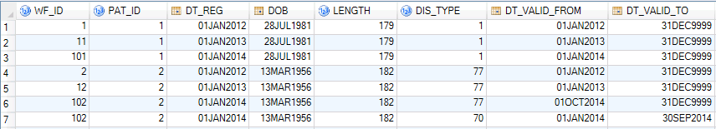
Corporate Data warehouse
Attributes
History

Slide 17
Recap: Data Validation Steps
Validate Technical and functional errors
Technical and functional errors detected during pre-checks are validated. → Possibility to ‘overrule’ or ‘confirm’ detected error.
1
Custom Checks and validations
Perform analyses on non-error data and validate the records if needed.
→ Possibility to ‘stop’ a record from being loaded further in the DWH.
2
Consolidate
Consolidate all data validations. An overview of all validations made.
→ Possibilty to go back to step 1 or 2.
3
Update STG
Update the STG control flow flags, to prepare the data for further loading into the DWH. An overview is given on how CDW will look like.
→ Possibilty to go back to step 1 or 2.
4
5
Load CDW
Start load process for further loading into the DWH

Slide 18
Data Analysis
Investigating the loaded data

Slide 19
Data Analysis
DWH
Staging
Corporate Data Warehouse
Dimensional Modelling
Exploitation
this is the basis for the aggregations
different data sources are combined for different dimensions
contains only valid records
used for analysis on detailed data
External

Slide 20
Data Analysis
DWH
Staging
Corporate Data Warehouse
Dimensional Modelling
Exploitation
External
the data are aggregated
we have 2 versions of this layer:
internally accessible by Enterprise Guide
externally accessible. This is a published version of the first.

Slide 21
How To
Request access

Slide 22
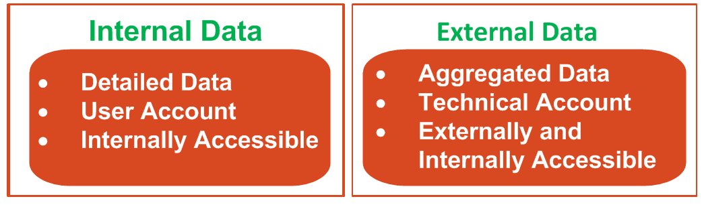
User access
Access to data is provided through user access
Data is stored per register
Access is managed by security officer or register manager
Access is possible to the internal or the external infrastructure
A user can be granted access to all data or a part of data from a register

Slide 23
How To
Citrix

Slide 24
Citrix
Request access to Citrix
Request via DPO
User and password are created by DWH
Validation account
Analysis account
Log on to Citrix via 2-way authentication
User/password
SMS code

Slide 25
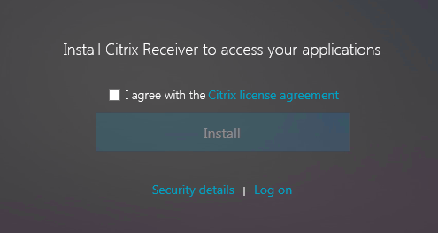
Citrix
Use Google Chrome (better than Internet Explorer)

Slide 26
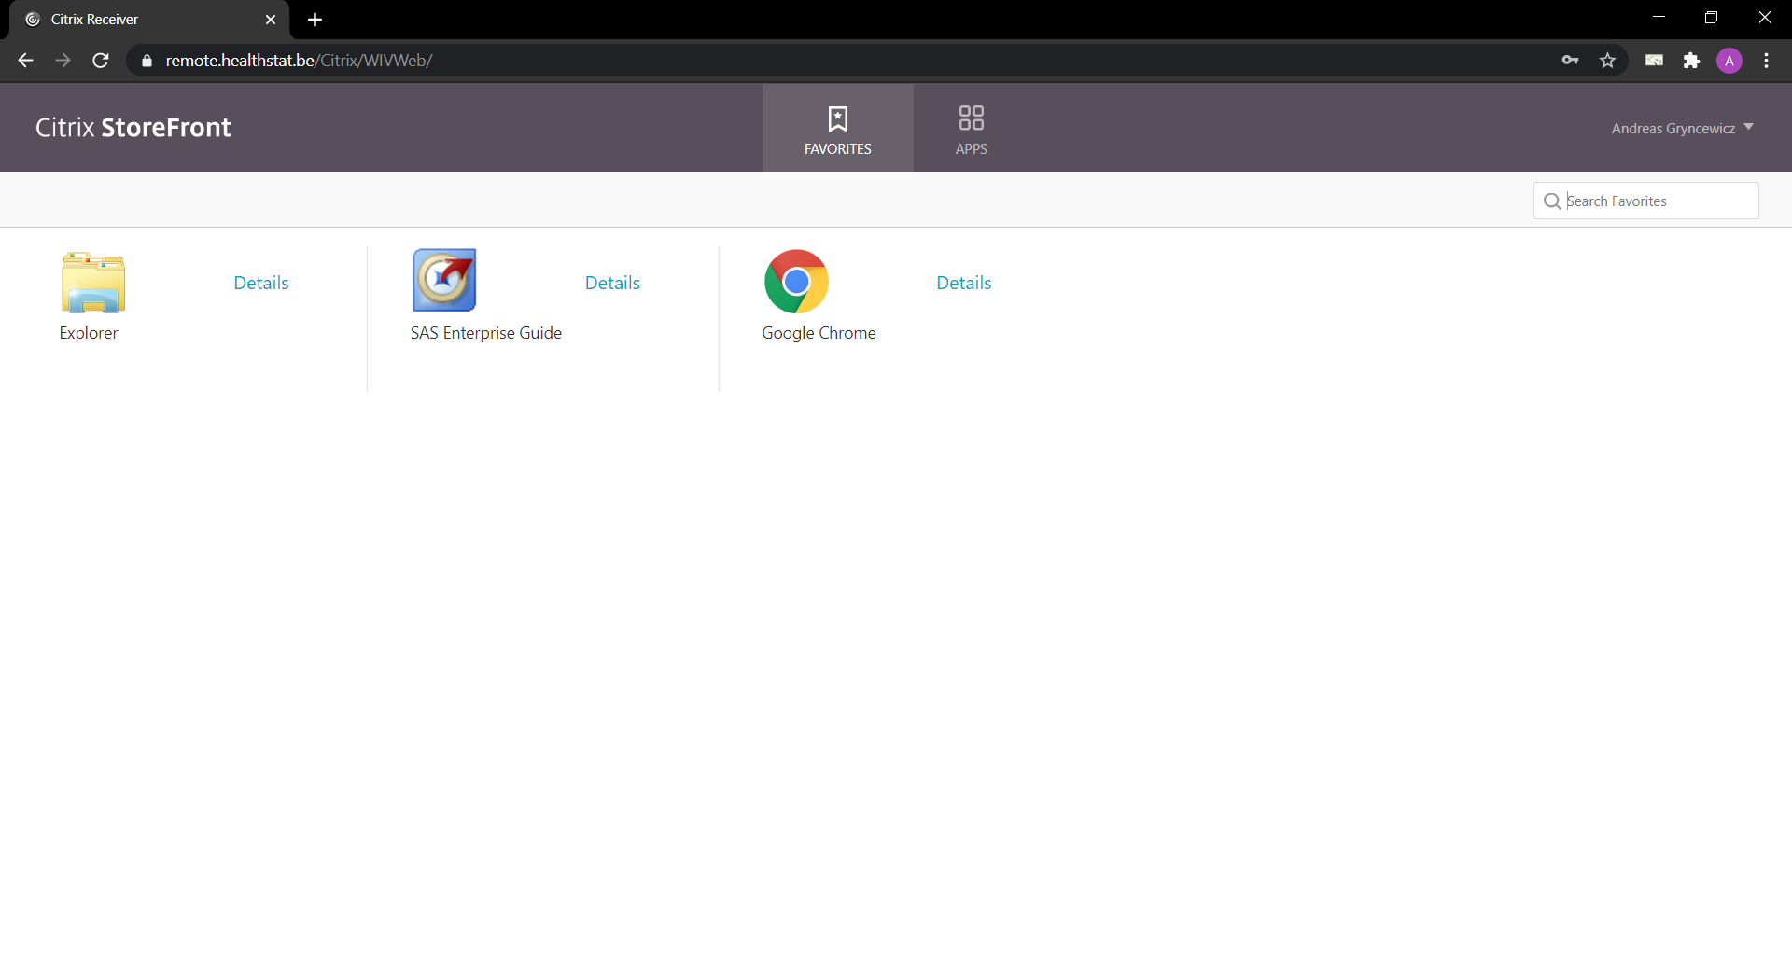
Citrix
Once the Citrix Receiver is installed, you have to activate it in the browser window on the page https://remote.healthstat.be

Slide 27
How To
Enterprise Guide

Slide 28
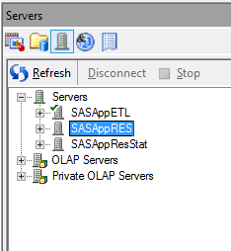
Enterprise Guide
Before :
DWH creates analysis environment
SAS environment => SASAppRES
Tables are created containing all validated data
User and password are the same as for connection to Citrix

Slide 29
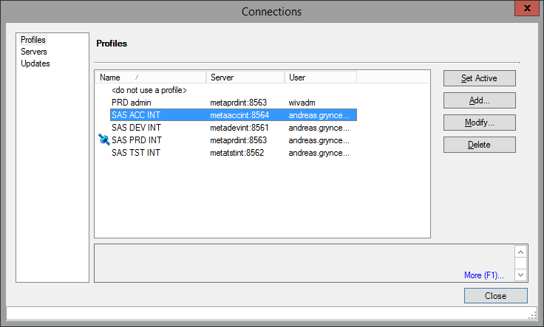
Enterprise Guide
At first time use, you get screens asking you to connect to a SAS Metadata Repository

Slide 30
Enterprise Guide
We have created 2 connections for you:
PRD
ACC
We have NOT saved your credentials in the connections we set up.
Your account and password for both Acceptance and Production are the same

Slide 31
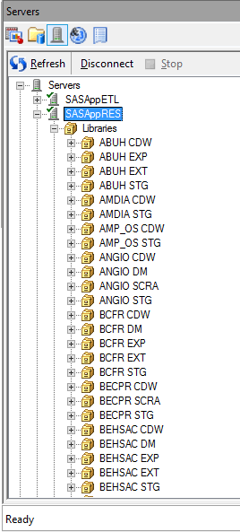
Enterprise Guide
The registers you are allowed to investigate are visible

Slide 32
Enterprise Guide
You can now :
Browse the data
Write queries in SAS
Generate code to make statistics

Slide 33
DWHHealthdata@sciensano.be

