Slide 1

ICT Info session
14/06/2024
This meeting is recorded for purposes of meeting minutes, delayed viewing by absentees, and internal (HD) operations. The recording will be stored internally, accessible by Sciensano employees, and temporarily by invitees.

Slide 2
CONTENTS
Announcements
Open Questions & Answers
Topics for Discussion
Round Table
Next Time

Slide 3
ANNOUNCEMENTS
 | WHAT | KEY INFO | KEY DATES
1 | Pitter Registry HDBP0078 | Biomarker list C to be updated Currently adapted code is available in DOCs in the additional information section Alternatively, you can access it by clicking this link Changes will be highlighted in yellow in the adapted DCD Email communication will be sent out in the coming days | Implemented as of July 1st, 2024
2 | EAM 3.1 | New version available featuring some user-friendly tweaks. Tutorial provided on May 31st on the new functionalities is available via this link. | Week of 17th June

Slide 4
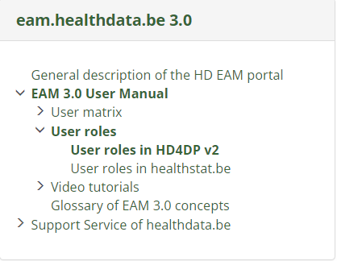
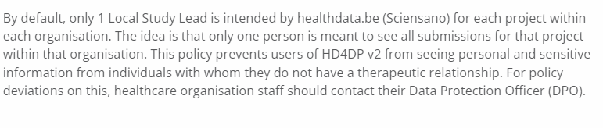
Announcement - User roles in HD4DP2
As is…
As is…
Will be…
The scope of the access rights is to prevent users of HD4DP v2 from seeing personal and sensitive information from individuals with whom they do not have a therapeutic relationship. The access rights therefore do not necessarily reflect the hierarchy within the healthcare organization. The healthcare organisation staff can consult their Data Protection Officer (DPO) for more in depth information concerning these access rights.
It is up to the Access manager to approve or change roles from/to Local Study Lead, Local Study Associate and Local Study Support. These requests are carried out in the EAM system by the Access managers of each healthcare organization.

Slide 5
OPEN QUESTIONS – Previous session
NAME | QUESTION | ANSWER
Kristien Aerts AZ St Jozef | RITM0015371: Access to Healthstat requested | This access request was made in EAM 3.1, the integration of which into Healthstat is still not ready at the moment. Once the integration is complete we can resolve this matter for you.
Thomas Elskens UZ Brussel | INC0214033: How does it come sometimes registrations are visible in the healthdata UI, sometimes can be found in the nippin DB, but appear to be absent from the localdatawarehouse? | A bug has been detected on our side which relates to bulk uploads which we are in the process of resolving.
Dirk De Beule UZ Gent | INC0213995: JRE en Log4j vulnerabilities on vhd4dpp.ai.internal.uzgent.be | Response provided to the ticket on 12/06
Pieter & Annemie Leemans | NIC flow issues for NexuzHealth hospitals | We are aware of the fact that this issue has been ongoing for quite a while and we’re still in the process of trying to resolve it.

Slide 6
OPEN QUESTIONS – Previous session
NAME | QUESTION | ANSWER
Kristien Dauwe UZ Gent | INC0214100: When using API in ‘draft’ mode, we notice that implant data isn’t visible in the ACC environment | We have taken note of the issue and created an internal ticket for it and will work on resolving it as soon as possible. Currently, a few other issues with a higher priority need to be addressed.
Erik Vanden Meersch NexuzHealth | INC0214112: BECPR can not register although data correct | Investigation is ongoing
Erik Vanden Meersch NexuzHealth | INC0214106: BCFR : can not make sense of error messages when registering via API | Response to the ticket provided on 12/06
Thomas Elskens UZ Brussel | INC0213694: Missing NIPPIN code for a registration | Issue resolved on 06/06

Slide 7
OPEN QUESTIONS – Previous session
NAME | QUESTION | ANSWER
Thomas Elskens UZ Brussel | INC0213401: 51 invalid submissions in NIPPIN database | Investigation is ongoing
Thomas Elskens UZ Brussel | INC0214065: A further 6 invalid submissions in NIPPIN database | Investigation is ongoing
Wilfried | Requested the MyCareNet validation script which was provided to Dirk De Beule | An email has been sent to all ICT contacts with a link to the location of the script. For convenience it’s provided here as well: https://docs.healthdata.be/documentation/hd4dp-v2-health-data-data-providers/nippin-validation
Thomas Elskens UZ Brussel | INC0213694: Missing NIPPIN code for a registration | Issue resolved on 06/06

Slide 8

ROUND TABLE APPROACH
Collaborative sessions around your questions & queries
We want to build the ICT info sessions around your topics!
What topics would you like to see in the ICT info session?

Slide 9

BI-WEEKLY ICT MEETING

Slide 10
APPENDIX

