Slide 1

ICT Info session
19 / 04 / 2024
This meeting is recorded for purposes of meeting minutes, delayed viewing by absentees, and internal (HD) operations. The recording will be stored internally, accessible by Sciensano employees, and temporarily by invitees.

Slide 2
CONTENTS
Announcements
Open Questions & Answers
Topics for Discussion
EAM 3.0 documentation
Round Table
Next Time

Slide 3
ANNOUNCEMENTS
WHAT
WHY
WHEN
Spine Surgery (HDBP0240)
Business Key fix
Solve the current incomplete and incorrect business key issues
Thursday 18th April
Registrations won’t be possible
Wednesday 24th April
Confirmation of Go/No-Go
1
DOCs website
EAM 3.0 documentation
Streamlined the documentation to make it more user-friendly. User feedback driven.
Wednesday 17th April
2

Slide 4
OPEN QUESTIONS – Previous session
NAME | QUESTION | ANSWER
Laurent Crabbe CHWAPI | We still don’t have a response to our tickets related to the MyCareNet flow. We require some feedback on the below tickets in order for us to progress. Can you please propose a few slots within the first two weeks of April for a Chwapi-HD session? Tickets: INC0212831 – problem reconciling registration data and MyCareNet sending information because of missing registration code INC0213527 - INC0212782 closed without being resolved and without explanation as to what needs to be done in the future should this issue reappear INC0213531 – Messages delivered to MyCareNet with status ‘SENT’ which apparently were never sent to them. Verification by HD and INAMI yet to be finalized. INC0213529 – MyCareNet messages sometimes receive an ‘INVALID’ status. Since mid-January, we are also receiving ‘ERROR’ messages. How do we address these issues and prevent them in the future? RITM0014974 – Concerns all registries. Could you please only close tickets RITM0014218 and RITM0014315 once all registrations with ‘ARCHIVED’ status have been sent? | INC0212831 & INC0213527 – Payload received. Currently being investigated by the development team. INC0213531 – Pending investigation INC0213529 – We detected a total of 19 errors for Chwapi, which we will be investigating. As a side note, most of the time an error occurs it is due to communication with MyCareNet. A solution would be for us to re-process them. Update – No more errors for Chwapi. Fixed on 17/04/2024. RITM0014974 - Messages are set to ARCHIVED, only if the NippinCleanup table has 0 records. These messages will not be processed and won't receive any attention afterwards.

Slide 5
OPEN QUESTIONS
NAME | QUESTION | ANSWER
Jonathan Hooft ZNA | We have received the call to export and import the stable data for BFCR. We have tried to follow the docs pages (https://docs.healthdata.be/documentation/belgian-cystic-fibrosis-registry/retrieve-bcfr-data-local-database-hd4dp-v2). We have not managed to complete the first step. Can you help provide us with some technical support to access the local database so we can extract our CSV. We also need login credentials for the SFTP server to upload the csv described in step 3. | This is an issue encountered by a number of hospitals. We will investigate internally and subsequently adapt our documentation to be more understandable The documentation available on DOCs doesn’t cover your particular issue, so will need to make appropriate adaptations. – this has been put on the features and functions roadmap. Time for development unknown for the moment.
Lisa Koninckx Chipsoft | During last Friday's ICT information session, Annelies and I asked a question about displaying error messages during CSV upload. We submitted a ticket with an example for this, see text below. Could you please take a look and see if this process can be further optimized? We created ticket RITM0015304 for this question. | Resolution in progress.
Florin Petrisor Chirec Delta | Our Linux HD4DP V2 server is no longer responding. Our infra team needs help to re-cooperate this server. Can we use a backup to re-cooperate the server? Thank you in advance for your quick response. (INC0213757) | In progress. We’ll need to contact you in order to resolve the issue

Slide 6
OPEN QUESTIONS
NAME | QUESTION | ANSWER
Jonathan Hooft ZNA | We have received a notice for NIC-flow and that our data should be exported and uploaded. De have received a link to the docspages: https://docs.healthdata.be/documentation/hd4dp-v2-health-data-data-providers/option-1-mycarenet-xml-export-dcd-name but this does not seem to work. 1. For Ziekenhuisnetwerk Anwerpen and Gasthuiszusters Antwerpen there are no Nippin-folders visible in our FTP-client. 2. How do we provide these xml files to Mycarenet? 3. From a clinical side we would like to know what purpose this xml file serves or which previous process/workflow this replaces? (INC0213939) | 1. Are you connected to the correct server, port and user? This is not the same connection used for CSV upload. 2. Riziv already send an email to each Dataprovider and documentation of Intermut (mycarenet) This will help the Dataprovider to automate the reimbursement flow which was/is currently manually being done by dataproviders. Option 1: we provide the XML files but they have to see how to send this to NIC, this is not part of our responsibilities. Option 2: we ensure the integration if they provide us the P12 certificate I have forwarded an email from RIZIV to you which should explain quite a bit.

Slide 7
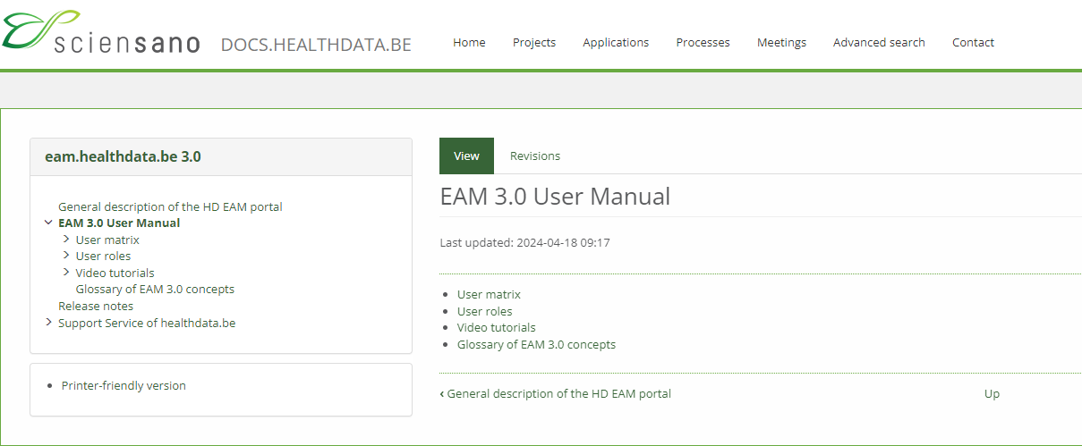
EAM 3.0 Documentation
https://docs.healthdata.be/documentation/eamhealthdatabe-30/eam-30-user-manual

Slide 8

ROUND TABLE APPROACH
Collaborative sessions around your questions & queries
We want to build the ICT info sessions around your topics!
What topics would you like to see in the ICT info session?

Slide 9

BI-WEEKLY ICT MEETING

Slide 10
APPENDIX

