Slide 1

ICT Info session 08 / 03 / 2024
This meeting is recorded for purposes of meeting minutes, delayed viewing by absentees, and internal (HD) operations. The recording will be stored internally, accessible by Sciensano employees, and temporarily by invitees.

Slide 2
CONTENTS
Announcements
Open Questions & Answers
Topics for Discussion
NIC Flow
EAM Issues
Use of Clinical Building Blocks in Data Collections
VPN Solution
CSV Result File
Round Table
Next Time

Slide 3
ANNOUNCEMENTS
WHAT
WHY
WHEN
Hospital Software Survey
Second ‘launch’ of the survey
Complete survey
Because several hospitals didn’t complete the questionnaire
Friday 8th March 2024
Reminder to be sent to hospitals yet to have responded
1
EAM Multiple Roles Situation
Users having multiple roles for a single project per account encounter issues
Potential to cause problems downstream systems (HD4DP2)
Detailed explanation provided in a later slide
Week 11/03-15/03
Communication to be sent
2

Slide 4

OPEN QUESTIONS & ANSWERS
NAME | QUESTION | ANSWER

Slide 5
TOPICS FOR DISCUSSION
NIC Flow
EAM Issues
Use of Clinical Building Blocks in Data Collections
VPN Solution
CSV Result File

Slide 6
NIC FLOW

Slide 7
NIC FLOW OPTIONS
Option 1: MyCareNet Export
Option 2: MyCareNet integration
Default option in HD4DP v.2.
HD provides XML files - ready to use.
These can be downloaded using an SFTP client of your choice. The XML files you download can be sent using the MyCareNet component available in your organization.
Note that it is the responsibility of the hospital to send the XML files to the National Intermutual College (NIC). This should be done through the MyCareNet component set up by the hospital itself.
Hospitals that chose this option, share their P12 certificate with healthdata.be.
If this certificate was shared correctly, the hospital does not need to do anything, and the XML files are forwarded directly to National Intermutual College (NIC) via HD4DP v.2.
Note that this option will be replaced soon by a self-service Portal to facilitate the usage. Hospitals currently using this option, will be contacted to give their feedback on this proposed solution.

Slide 8
EAM Issues

Slide 9
EAM Multiple Roles
CHALLENGE | SOLUTION | TEMPORARY WORK AROUND
EAM allows assigning multiple grants for the same project with different roles to a user account, which can cause issues in downstream systems expecting only one role per account per project. On project level, only the highest level role should be kept | If a user has the following grants for Project HDBP0000: Local Study Lead (authorgroup = “John Doe”) Local Study Support (authorgroup = “Jane Smith”) Keep only the “Local Study Lead” role, as it is the highest level. | Ensure each user has only one role per project when assigning grants If a user has multiple grants with different roles for the same project, keep only the highest level role (e.g., Local Study Lead) and remove the lower-level roles (e.g., Local Study Associate or Local Study Support) Note: EAM 3.1 will introduce a validation check to prevent this issue. Until then, please follow these guidelines to avoid problems with downstream systems

Slide 10
Incorrect User in Author Group Resource Causing Form Loading Issues
CHALLENGE | INVESTIGATION | SOLUTION | NEXT STEPS
When an author group resource is changed, the referencing user in author group with role was not updated correctly by the provisioner. This results in forms not loading in the frontend for affected users. The issue has been reported in SNOW tickets: INC0213613, INC0213579, RITM0015026, and RITM0015018 | In INC0213579 and RITM0015026, manually recreating the "User in Author Group with Role" resources in form.io resolved the issue. Comparison of JSON responses for affected and unaffected users revealed extra values in the roles array for affected users. | Delete all the authorgroupWithRole resources in form.io for affected insallations. Force an EAM Update request for affected accounts / data providers to fix the access issue. | Implement the proposed solution to resolve the form loading issues for affected users. Intervention is planned for affected installations

Slide 11
USE OF CLINICAL BUILDING BLOCKS
IN Data collections

Slide 12
Content
What?
Why?
How?

Slide 13
WHAT?

Slide 14
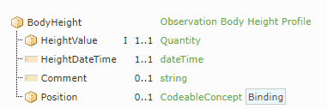
Clinical Building Blocks
“Zorginformatiebouwstenen” (ZIB’s), designed in the Netherlands by NICTIZ (Nationaal ICT-instituut in de Zorg)
Definition: information model in which a care-based concept is described in terms of the data elements from which that concept exists, the data types of those data elements, etc
Example: “Body height”

Slide 15
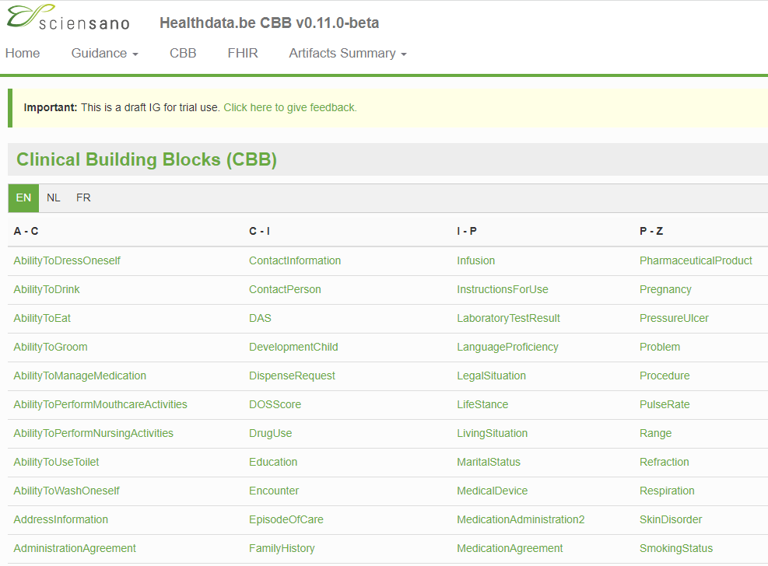
Clinical Building Blocks on Simplifier
ZIB Release 2020 containing 110 ZIB’s
Adopted by healthdata.be as logical models and referred to as Clinical Building Blocks
Modified to Belgian context and published on Simplifier in 2022: healthdata.be CBB webpage
https://simplifier.net/guide/HdBe-R4-CBB/Home/CBB.page.md?version=current

Slide 16
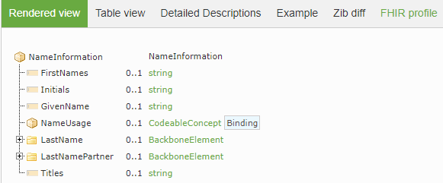
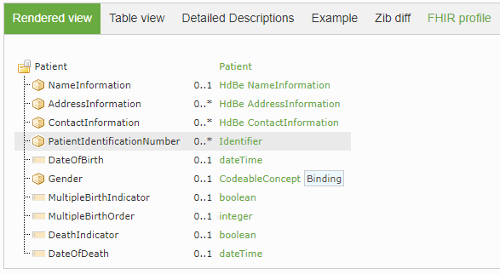
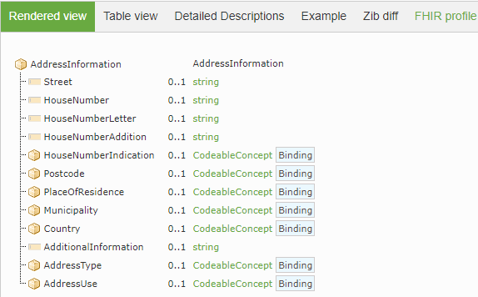
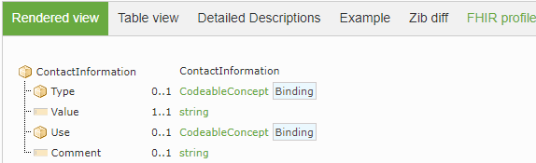
Example 1: CBB HdBe Patient
Partial CBB
Partial CBB
Partial CBB
Data elements
Cardinality
Notes:
https://zibs.nl/wiki/AllergyIntolerance-v3.2(2017EN)

Slide 17
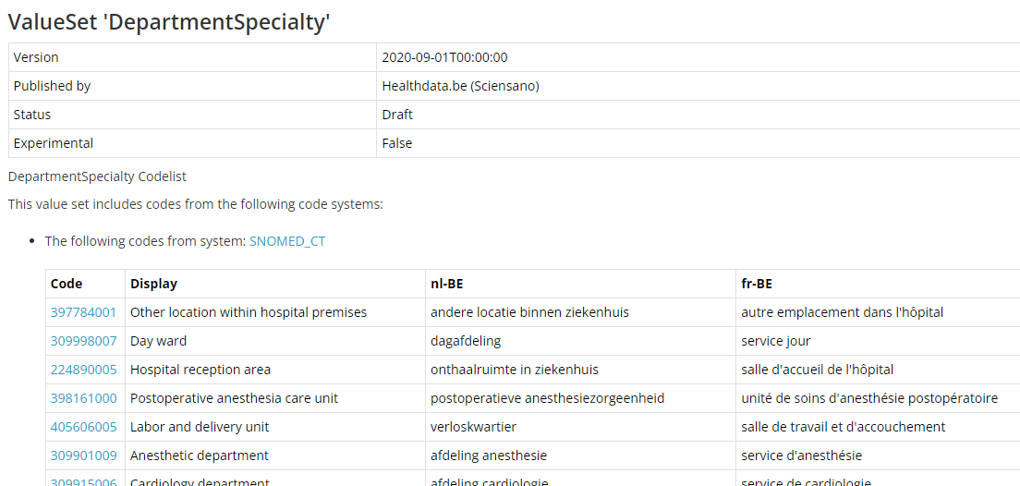
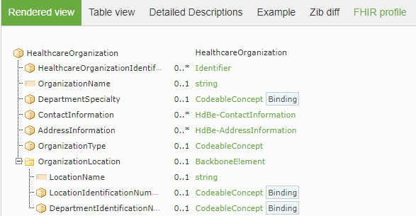
Example 2: CBB HdBe Healthcare Organization
Terminology binding

Slide 18
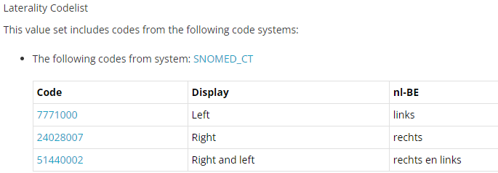
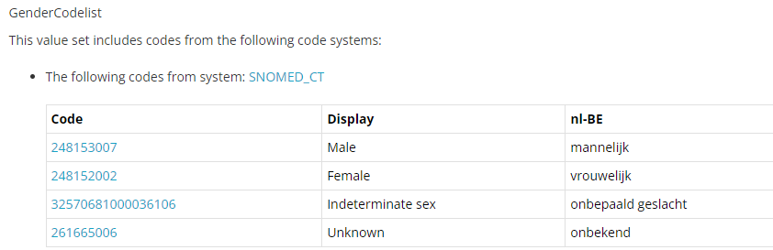
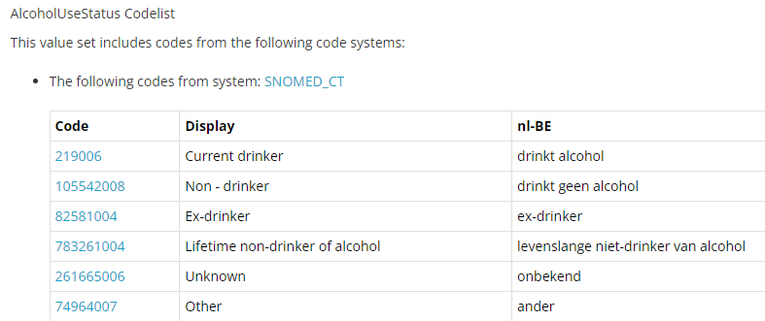
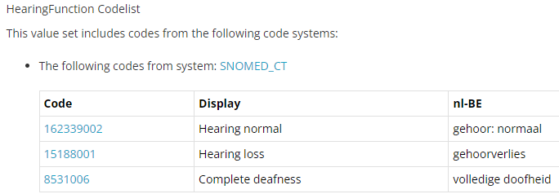
Use of terminology

Slide 19
WHY?

Slide 20
Healthdata.be mission statement
“Policy makers must have access to up-to-date, reliable and valid scientific reports in a fast and autonomous manner in order to develop and (re)adjust their policy.
To compile these reports, researchers need tools (technical & administrative) that they can use quickly, easily and autonomously to collect and process the desired data in a reliable and effective manner.
The collection of this data should not generate any administrative or technical burden for the healthcare providers concerned or their service providers and should guarantee maximum privacy and data protection for healthcare providers and patients.”
Sytem to system
NEED FOR STANDARDIZATION

Slide 21
Interoperability
Common “understanding” (logical data models) of content that needs to be exchanged (reuse mapping across multiple DCD’s)
Generic structure and format of messages that need to be exchanged
System to system transfer of data (only once)

Slide 22
HOW?

Slide 23
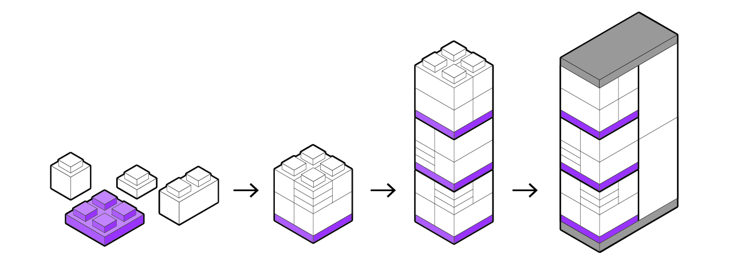
Clinical Building Blocks towards a DCD
Components
Data elements
Terminology
Structure
CBB
HD Data collection definition
https://www.nictiz.nl/gegevensuitwisselingindezorg/
Notes:
https://www.nictiz.nl/gegevensuitwisselingindezorg/

Slide 24
Example: LaboratoryTestResults DCD composed with CBB’s
Patient
HealthProfessional
HealthcareOrganization
LaboratoryTestResult
demo Epilabo DCD specs (~ pandemic preparedness)
2 instances: Requester and Performer

Slide 25
Implementation CBBs within HD: challenges
Add all CBB elements (hidden / local)
Add CBB elements with cardinality 1 (hidden CBB fields)
Mapping to CBB elements
Generic messages
LaboratoryTestResults
- ClinicalReportResearch

Slide 26
Implementation CBBs within HD: exploration on Data Provider side
Knowledge of CBB’s?
Current use of data modelling in EPD’s? (CBB’s, care sets, …)
Current use of terminology in EPD’s? (SNOMED CT, LOINC, ICD-10)
Readiness? (advantages for DP’s to adopt data modelling through CBB’s)
Preferences in approach?
Only data elements that are needed
Only data elements that are needed + data elements with cardinality 1
Use all data elements

Slide 27
STANDARD VPN Project Proposal

Slide 28
STANDARD VPN SOLUTION
Challenge:
Supporting multiple VPN solutions is causing a lot of operational and administrative overhead along with impacting time to resolution of the tickets –
AS IS:
Supporting 16+ VPN solutions (TeamViewer, Bomgar, Fortinet, Cisco, BigIP Edge, etc.)
No standardised approach for connecting to all DP
Impact:
Average time to connect to DP (30m to 2h+) Tickets are not being resolved on time
Increase of administrative backlog and operational overhead for technical teams
Security risk due to lack of password rotation at DP etc.
TO BE:
1 VPN solution for all – standardised approach
Isolated robust secure solution with logging (Better security, Access Mgmt. Time Saving)

Slide 29
CSV RESULT FILE

Slide 30
RESULT FILE
Challenge:
Data provider would like to have a file that contains the results per CSV upload.
AS IS:
1 result file for all CSV uploads per day
Impact:
Data provider unable to perform an accurate search per each CSV record
Result file is too large and not user friendly for a human to read
TO BE:
Save the result file information into DB to be queried
GUI for user friendliness

Slide 31

ROUND TABLE APPROACH
Collaborative sessions around your questions & queries
We want to build the ICT info sessions around your topics!
What topics would you like to see in the ICT info session?

Slide 32

BI-WEEKLY ICT MEETING

Slide 33
APPENDIX

