Slide 1

ICT Info session
13 / 10 / 2023
This meeting is recorded for purposes of meeting minutes, delayed viewing by absentees, and internal (HD) operations. The recording will be stored internally, accessible by Sciensano employees, and temporarily by invitees.

Slide 2
Agenda
Q&A Backlog
Technical Problems 4/10
HD4DP2 Metrics
Incidents Report
EAM 3.0
DCD Updates
Varia

Slide 3
Q&a backlog

Slide 4
Data transfer
 | Question | Answer
Q1 | Correction of a submission - Can you explain how to update a registry already submitted first in the web app and then via api? | There are 2 ways to send a correction: - Preferred way: Send the complete record again. The latest version will be considered the correct version. It doesn’t matter via which way the record is sent, the latest send record (based on the business key) will be indicated as the current active record. - You can also use the correction form. Based on the business key a correction can be sent. Be aware, only 3 fields can be corrected with 1 correction form. If multiple fields need to be corrected, please send the complete record again. Please consult https://docs.healthdata.be/documentation/hd4dp-v2-health-data-data-providers/send-correction-registration.

Slide 5
Technical problems 4/10

Slide 6
Technical Problems 4/10
Problem Statement:
General technical issues across applications and network
Duration: 1.5 weeks
Impacted services:
Healthstat v3, HD4DP2 Online Acceptance Environment, HD4DP2 Demo environment, SSO & the Project Delivery Pipeline
Solution:
Set-up temporary secondary environment and migrate the databases. Test and validate all services use cases to ensure we could resume services as normal.
Next Steps:
Investigate root cause and work towards resuming services in the primary environment
Business Impact Assessment (BIA) to ensure future Business Continuity of HD Services

Slide 7
STATUS
All impacted services are available once again
Quality Assurance teams continue validating functional and use cases
Root Cause Analysis ongoing
Technical teams started to work on resuming the services in the primary environment

Slide 8
HD4DP2 Metrics

Slide 9
HD4DP2 Metrics (as of 12/10)
 | Metric | Count
 | No updated metrics available

Slide 10
Incidents report

Slide 11
Total Open Incidents And Requests

Slide 12
Total Closed Incidents And Requests

Slide 13
Workload and focus
EAM 2.7 backlog
Password reset

Slide 14
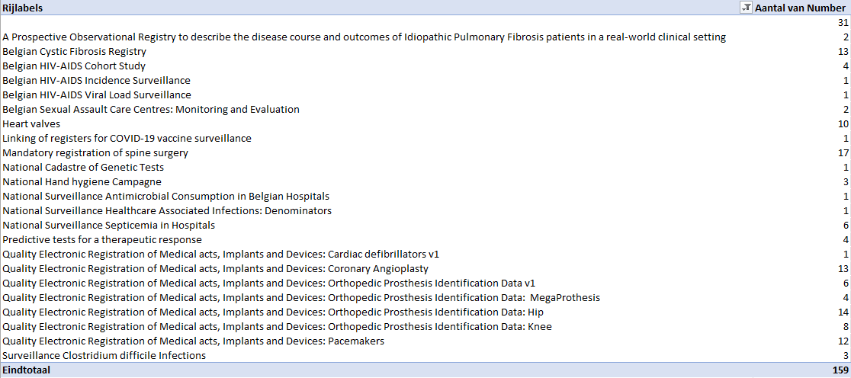
Incidents And Requests per Project – not ‘closed’ state

Slide 15
EAM 3.0

Slide 16

EAM 3.0
EAM is PRD ready!
Release process has been initiated
EAM Pilot is ongoing
EAM Documentation is available on DOCS
Full manual
Slide deck
Short explainer videos

Slide 17
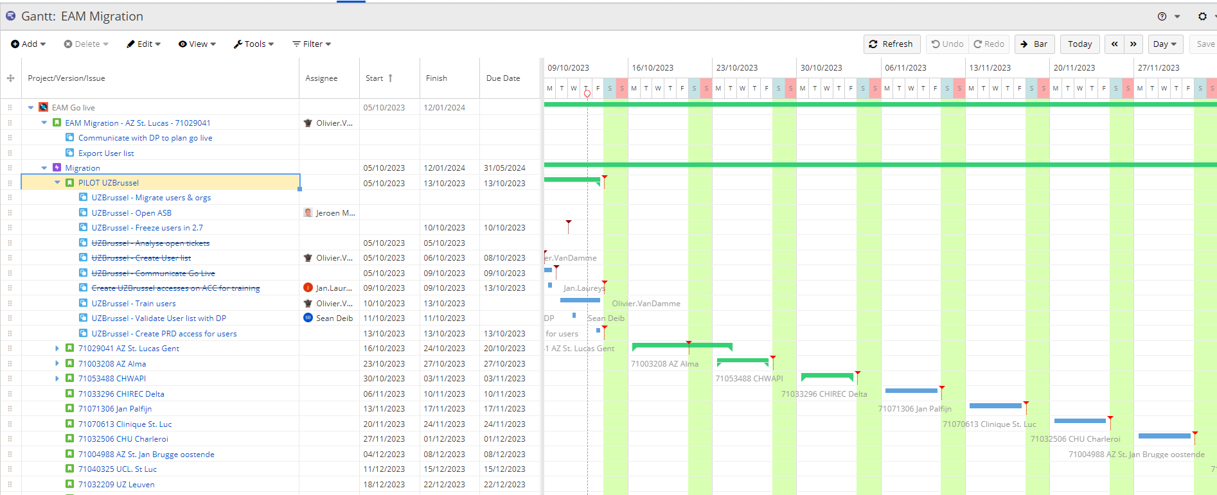
EAM 3.0
First batch of Data Providers is being prepared for Go Live:
Analysis of open tickets
  Solved now
  Solved after migration
Data Cleaning
Freeze 2.7
Training
Migration
Go Live!
Hypercare
Sequence based on:
Amount of users
Amount/type of issues raised via ticket
Complexity of issues

Slide 18
DCD updates

Slide 19
DCD Updates
Project/DCD | Content
 | No updated DCDs this week

Slide 20
Varia

Slide 21
Varia
Topic | Message
Arch 2.5 | The release of Arch 2.5 on 2/10 had to be stopped due to issues originated during the production release. Work on Arch 2.5 is interrupted due to general application and network issues. No new release date planned yet.
User Accounts Validation for Orthopride | There are many pending account validations for the Orthopride project. The validation has to be done by the Access Managers.

Slide 22

Q & A

Slide 23








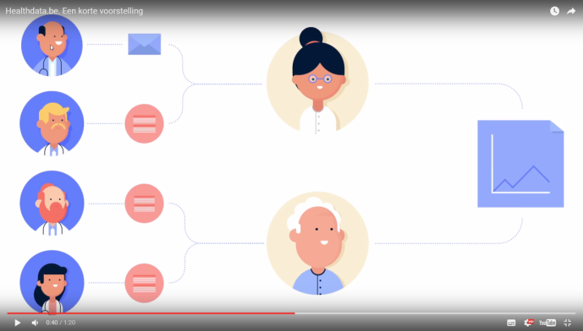
www.healthdata.be
healthdata@sciensano.be
Sponsored by
healthdata be
@healthdatabe

