Slide 1

ICT Info session
27 / 10 / 2023
This meeting is recorded for purposes of meeting minutes, delayed viewing by absentees, and internal (HD) operations. The recording will be stored internally, accessible by Sciensano employees, and temporarily by invitees.

Slide 2
AGENDA
Open Questions & Answers
Major Release 30 October 2023
CSV Folder Structure
Demo: How to use s2s
Demo: How to use CSV-Upload
Supporting Mapped Applications

Slide 3
Open Questions & Answers

Slide 4
Open Q&A
Hospital | Question | Answer
St Luc | Is there a service which generates unique IDs? | In HD we have a registration service which generates unique IDs for submitted DCDs which is sent to MyCareNet - Unique generated ID is the ID that is used on the invoice. We have checked to see if the registration ID is available in your local DWH – we found 1211 records - Key: TX_REGN_CD - You can query this: local_dwhmessage_key_value table in localdwh OR go to https://docs.healthdata.be/documentation/hd4dp-v2-health-data-data-providers/retrieve-data-local-database-hd4dp-v2
St Luc | Can we have more standardization in the API logic across all register types? | Can you please provide us with some use cases that the APIs are causing you issues?
St Luc | The format and wording of the error messages provided by the HD4DP API platform are not structured, some errors are labelled in Dutch language | If DCD is not available in English – the default is Dutch. If French is available then it will be in French – this information comes from our department that handles the DCDs and we implement it. HD4DP2 API has a structured error service but this is referring to the errors that are coming from the DCD
St Luc | The DOCs documentation is suboptimal. Our team has been struggling to get simple things done, such as integrating our HD4DP server with MyCareNet. | Are you able to provide examples on the DOCs page so that we can inform the Onboarding team

Slide 5
Open Q&A
Hospital | Question | Answer
St Luc | We also opened a number of tickets with Sciensano for simple requests such as granting us access to HD4DP2 so we can configure it to interact with MyCareNet. We have not received a timely follow up. | I will follow up with the service desk about your open tickets
St Luc | In Spine Registry (HD0240), we haven’t been able to successfully populate the internal patient ID field (numero d’identification interne du patient) field using a .csv file. Can you please confirm the correct header label for this field? The DCD file indicates that the header is TX_IDC_PAT_INT, but in our tests in Acceptance, we receive the message that the header field cannot be found. | Upon investigating this issue, our IT team discovered that the key could not be found in the MDM, so a ticket has been logged with our development team to resolve the issue. This has been fixed / tested and is in PRD since October 10
St Luc | Here as some tickets we created listing the aforementioned issues: INC0212310 INC0212110 | INC0212310 – resolved but not deployed in PRD – you are able to test it on the OACC - Will be planned to go into PRD November 06 a week after the A2.5 deployment
St Luc | Generic NISS is assigned to patients who don't have one but the business key returned after the submission is empty. What's the logic behind this NISS allocation? | There should always be a business key generated when you submit a record. Which DCD are you referring to please?

Slide 6
Open Q&A
Hospital | Question | Answer
St Luc | Issue with the nippin db couple of weeks ago INC0212557, I also asked a question about the same topic for ICT session RITM0014043 | The URL that you are using is not white listed by you. You need to add this to your white listing.
St Luc | Is there any status for the second submission like "updated"? Is there a maximum time allowed to make a correction? | There is a way to check to the last time it was updated – There is a filter
CHU Charleroi | One patient received CABG on 4 segments – challenge interpreting error message | Ill speak with IAT and bring this to QERMID who were the ones whom originally created the error messages
CHU Charleroi | Could you describe me such a complex and multiple clinical situation and the JSON translating this situation ? (TX_TTL_DISCH_DATA) | We do not have enough insight in the details of the procedures that can take place in the hospital to give a realistic example – we will address this directly with the QERMID team

Slide 7
Open Q&A
Hospital | Question | Answer
Nexuz Health | The account francois.vermeulen@uzleuven.be does not allow us to register(via API) anymore since months, although it worked before. We keep getting : TX_AUTHOR_GR must be correctly informed and exists on DB Due to this we can not develop and debug, meaning also that all deadlines for this register are futile | User was created on 21 Sept and is participating only on the BCFR project The author group name is François Vermeulen We validated with S2S with that specific author group name
UZ Brussel | Re: Architecture 2.5 mailing which was sent out on 25th October. “And what about production URL ?” | Architecture 2.5 is not in PRD but there is a link that was sent out for OACC which are the following https://hd4dp.acceptance.healthdata.be/proxy/api/installation/project-result?organization-id=2&dcd-id=49 => arch2.5 https://hd4dp-arch20.acceptance.healthdata.be/proxy/api/installation/project-result?organization-id=2&dcd-id=49 => arch2.0
UZ Brussel | What is the status of INC0212214 ? I cannot test if this bug is solved with the new architecture... When will it be fixed? If not very very soon, we will not be able to used S2S for Coronary Valves Registry in 2023 - it will have to be done manually | The bug has been fixed and is currently in the test lane. Will be planned to go into PRD November 06, a week after the A2.5 deployment
AZ Palfijn Gent | Can you please take a look at ticket RITM0013861 it's open for 29 days? | MDM will be updated this week and in PRD on Monday night

Slide 8
PLANNED
MAJOR RELEASE

Slide 9



Night of 30 October
Architecture 2.5
Folder Name Changes
API Simplification
+
+
Performance enhancements
Uniformed naming convention across all applications
Sending Code values as CSV Upload

Slide 10

ABOUT: RELEASE
Identifying bottlenecks is becoming increasingly more difficult as application software becomes more and more complex.
It limits the system’s overall capability, leading to problems such as increased downtime, long load times, and high levels of end-user frustration.
A2.5 focus has been to increase performance and reduce technical overhead to provide the end user with a better experience.
Summary:
Reduce Application Bottlenecks
Increase HD4DP2 Performance
Provide Better User Experience

Slide 11
FEATURE CHANGE (SYSTEM 2 SYSTEM)
Simplification of system-to-system submission by sending code values instead of code IDs – like we have in CSV upload.
Developed to standardize the sending of forms, simplify the submission & increase performance
The purpose of this change is to stop sending the code IDs in S2S and start sending the code values, as we have today in the CSV upload.
The service will return the code value for a given ID through a single request per submission to the MDM.
To allow time for the data provider to map their applications we have created a new URL to the Architecture 2.5 environment to provide a place to test and validate.
Technical Documentation available: https://docs.healthdata.be/documentation/design-documents-hd4dp2/sending-code-values-instead-code-ids-system-system-requests

Slide 12

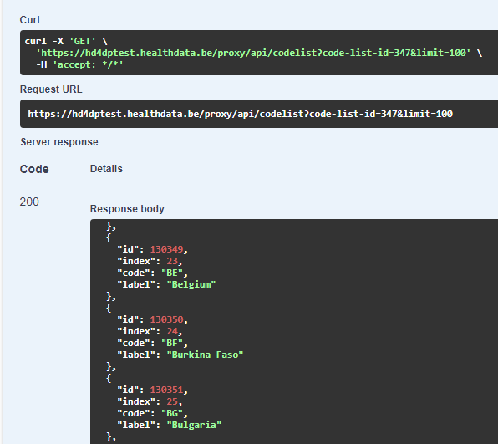
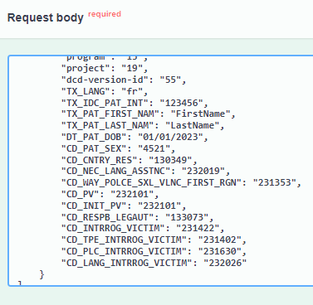
AS IS
CSV upload is done by sending code values
Code IDs could only be known through calls to our web services.
System-To-System was done by sending code IDs

Slide 13
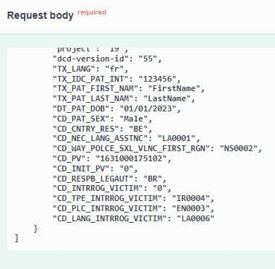
TO BE
CSV upload is done by sending code values
Architecture 2.5 requests via system-to-system are performed in the same way as the CSV upload. The code translations between the two types of submission are no longer required.
In addition, a lot of work has been done on optimizing the submission services and now the response times are much lower.

Slide 14
CSV Upload NEW folder Structure

Slide 15
FOLDER STRUCTURE
Type |  | Name |  |  |  |  |  |  |  | Description
dir |  | organization-{id} |  |  |  |  |  |  |  | Organization location
dir |  |  | csv |  |  |  |  |  |  | Organization home directory (SFTP user)
dir |  |  |  | {project name} |  |  |  |  |  | The name of the project
dir |  |  |  |  | dcd-{dcd-id}-v-{dcd-version}-{dcd-name}-v{dcd-version} |  |  |  |  | DCD location where to put the orignal csv file
dir |  |  |  |  |  | ARCHIVE |  |  |  | Archive location of processed csv files
file |  |  |  |  |  |  | {copy of original csv file} |  |  | Place where orignal csv is moved to
dir |  |  |  |  |  | ERROR |  |  |  | Error location of processed csv files
file |  |  |  |  |  |  | {copy of original csv file} |  |  | Place where orignal csv is moved to
dir |  |  |  |  |  | RESULT |  |  |  | Result location where result file is created in txt format
file |  |  |  |  |  |  | {result file with timestamp} |  |  | Result file containing log information about the processed csv file
OLD
Type |  | Name |  |  |  |  |  |  |  | Description
dir |  | {nihii} |  |  |  |  |  |  |  | Organization location (home directory of the sftp user)
dir |  |  | {HDfiletype}_{HDBPnumber}_{HDBPabbreviation}_{dcdname/abbreviation}_{versionnumber}_{versionreleasedate} |  |  |  |  |  |  | DCD location where to put the orignal csv file
dir |  |  |  |  | ARCHIVE |  |  |  |  | Archive location of processed csv files
file |  |  |  |  |  | {copy of original csv file with timestamp} |  |  |  | Place where orignal csv is moved to
dir |  |  |  |  | ERROR |  |  |  |  | Error location of processed csv files
file |  |  |  |  |  | {copy of original csv file with timestamp} |  |  |  | Place where orignal csv is moved to
dir |  |  |  |  | RESULT |  |  |  |  | Result location where result file is created in txt format
file |  |  |  |  |  | {result file with timestamp} |  |  |  | Result file containing log information about the processed csv file
 |  |  |  |  |  |  |  |  | Vars. | Description
 |  |  |  |  |  |  |  |  | {nihii} | ex. 71001129
 |  |  |  |  |  |  |  |  | {HDfiletype} | ex. HD_DCD_submcsv File type for submitting csv files, for drafts we can use HD_DCD_draftcsv
 |  |  |  |  |  |  |  |  | {HDBPnumber} | ex. HDBP0231
 |  |  |  |  |  |  |  |  | {HDBPabbreviation} | ex. ZEPHYR
 |  |  |  |  |  |  |  |  | {dcdname/abbreviation} | ex. ZEPHYR_REPLAC
 |  |  |  |  |  |  |  |  |  | ex. ZEPHYR_PRIM_IMPLT
 |  |  |  |  |  |  |  |  | {versionnumber} | ex. 1
 |  |  |  |  |  |  |  |  | {versionreleasedate} | ex. 20220808
NEW

Slide 16

CSV Upload

Slide 17
System 2 System

Slide 18
SUPPORT MAPPING APPLICATIONS

Slide 19

DIRECT SUPPORT DURING TRANSITION

Slide 20
APPENDIX

