Slide 1

ICT Info session 29 / 09 / 2023
This meeting is recorded for purposes of meeting minutes, delayed viewing by absentees, and internal (HD) operations. The recording will be stored internally, accessible by Sciensano employees, and temporarily by invitees.

Slide 2
Agenda
Q&A Backlog
HD4DP2 Metrics
Incidents Report
Architecture 2.5
EAM 3.0
DCD Updates
Varia

Slide 3
Q&a backlog

Slide 4
…
 | Question | Answer
Q1

Slide 5
HD4DP2 Metrics

Slide 6
HD4DP2 Metrics (as of 28/09 – compared with 21/09)
 | Metric | Count
 | Number of records received | Total : 63641 (+2434) - Manual 58684 (+2219) - CSV 1856 (+126) - API 3101 (+89)
 | User Accounts | Total : 7668 (+38)

Slide 7
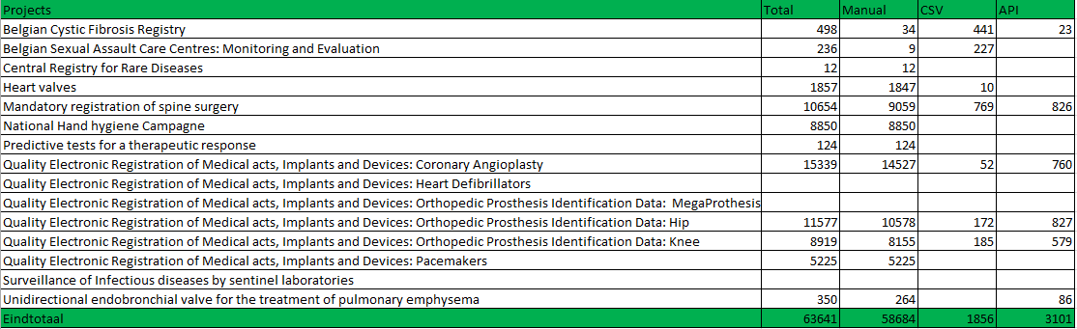
HD4DP2 Metrics (as of 21/09): received registration per project

Slide 8
Incidents report

Slide 9
Total Open Incidents & Requests

Slide 10
Total Closed Incidents & Requests

Slide 11
Workload and focus
EAM 2.7 backlog
EAM 3.0 testing
Password reset

Slide 12
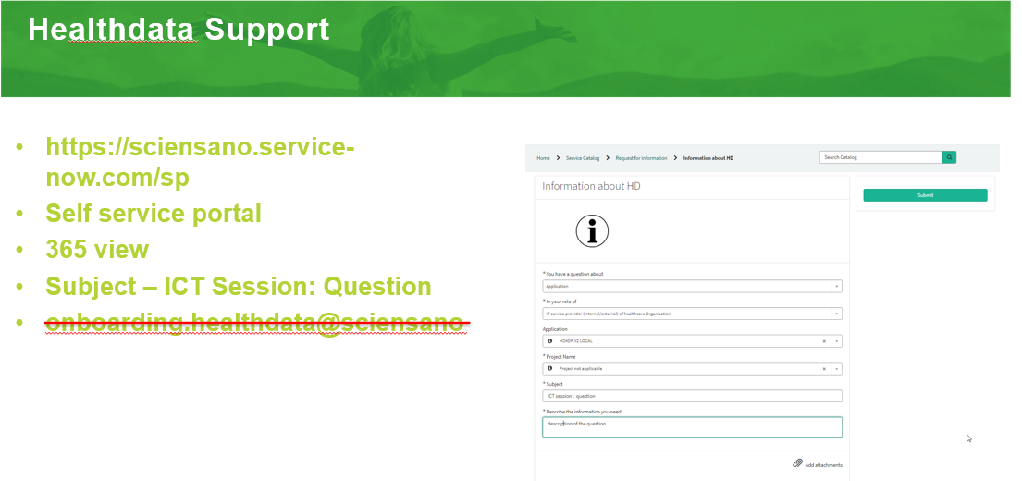
ICT Info Session - Request
No new tickets raised

Slide 13
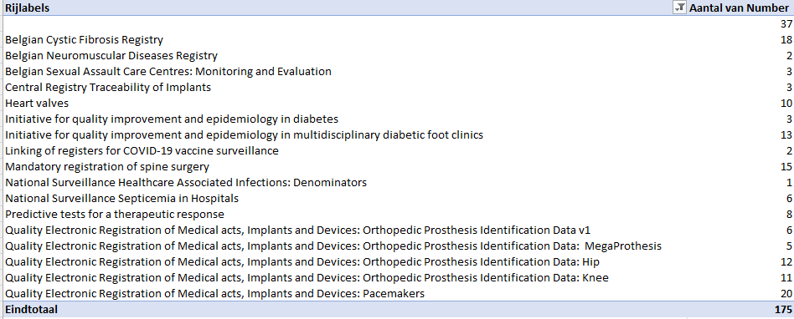
Incidents & Requests per Project – ‘not closed’ state

Slide 14
Architecture 2.5

Slide 15

ABOUT: Architecture 2.5
Identifying bottlenecks is becoming increasingly more difficult as application software becomes more and more complex.
It limits the system’s overall capability, leading to problems such as increased downtime, long load times, and high levels of end-user frustration.
A2.5’s focus has been to increase performance and reduce technical overhead in order to provide the end-user with a better experience.
Summary:
Reduce Application Bottlenecks
Increase HD4DP2 Performance
Provide Better User Experience

Slide 16
ALL ARCHITECTURE 2.5 CODE CHANGES
GET Form.io Details & Load Registrations to improve performance of the form submission
Changed the Validation of code lists to increase performance of the form submission
Get Author Group Service improvements and fixes for GET Author group to fix permissions
Redesign of CSV Uploader to remove the translations to code IDs to improve performance
NIPPIN billingcode lookup is processed in MDM now to support the MyCareNet Codes
NIPPIN backlog reprocessing to reprocess the incorrect MyCareNet Messages

Slide 17
CODE CHANGE PERFORMANCE EXAMPLES
PROBLEM STATEMENT
SOLUTION
RESULT
Service Response time was too high and impact the user experience
Remove unnecessary service calls to reduce response times.
The calls to "getFormDetails" and "loadRegistration" where replace by one single call to "getProject" in the FormIO service.
This reduced the time from 0.608625 seconds to 0.176846 seconds, contributing to a larger reduction in the total request time of the form submission. In some tests we managed to achieve reductions of up to 300%
Service Response time was too high and impact the user experience
The validation of code lists in the submission of System-To-System and CSV Upload was processed one by one.
The validation time went from a linear time depending on the size of the form to a constant time with an average of 0.043356 seconds, regardless of form size.
Language changes makes too many calls to the translation services
Save complete objects in the database thus removing the need of calling the translation services
Increased performance when opening a form and changing a language

Slide 18
HD4DP2 FEATURE CHANGE (SYSTEM 2 SYSTEM)
Simplification of system-to-system submission by sending code values instead of code IDs – like we have in CSV upload.
Developed to standardize the sending of forms, simplify the submission & increase performance
The purpose of this change is to stop sending the code IDs in S2S and start sending the code values, as we have today in the CSV upload.
The service will return the code value for a given ID through a single request per submission to the MDM.
To allow time for the data provider to map their applications we have created a new URL to the Architecture 2.5 environment to provide a place to test and validate.
Technical Documentation available: https://docs.healthdata.be/documentation/hd4dp-v2-health-data-data-providers/sending-code-values-instead-code-ids-s2s-requests

Slide 19
EAM 3.0

Slide 20
DCD updates

Slide 21
DCD Updates
Project/DCD | Content
 | No updated DCDs this week

Slide 22
Updates & communications

Slide 23
Varia
Topic | Message
EAM 3.0 release | The release of EAM3.0 is planned to be discussed on the Release Management Board of 10/10.

Slide 24

Q & A

Slide 25








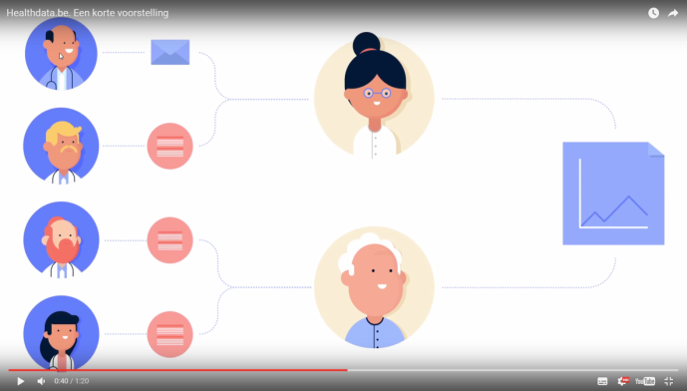
www.healthdata.be
healthdata@sciensano.be
Sponsored by
healthdata be
@healthdatabe

