Slide 1

ICT Info session 22 / 09 / 2023
This meeting is recorded for purposes of meeting minutes, delayed viewing by absentees, and internal (HD) operations. The recording will be stored internally, accessible by Sciensano employees, and temporarily by invitees.

Slide 2
Agenda
Q&A Backlog
HD4DP2 Metrics
Incidents Report
Issues MyCareNet
Updates & Communications

Slide 3
Q&a backlog

Slide 4
API
 | Question | Answer
Q1 | The account xxx@yyy.be does not allow us to register (via API) anymore since months, although it worked before. We keep getting : TX_AUTHOR_GR must be correctly informed and exists on DB | This error message indicates that the author group for the account is not present in form.io or that the author group is not configured to be participating in the DCD for which registrations are being to be made.

Slide 5
HD4DP2 Metrics

Slide 6
HD4DP2 Metrics (as of 21/09 – compared with 14/09)
 | Metric | Count
 | Number of records received | Total : 61207 (+2706) - Manual 56465 (+2226) - CSV 1730 (+187) - API 3012 (+293)
 | User Accounts | Total : 7630 (+142)

Slide 7
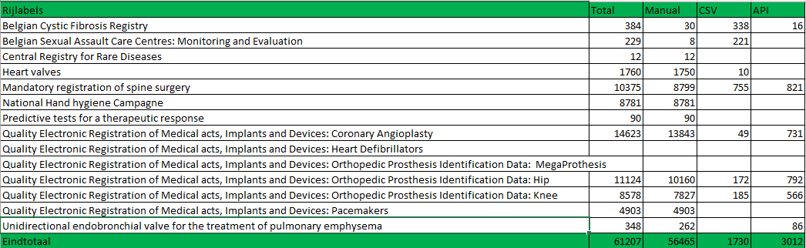
HD4DP2 Metrics (as of 21/09): received registration per project

Slide 8
Incidents report

Slide 9
Total Open Incidents And Requests

Slide 10
Total Closed Incidents And Requests

Slide 11
Decrease Open Tickets
EAM 2.7 backlog
70 tickets – 2 weeks
Additional resource
Improvement intake and MTTR

Slide 12
Incidents and request per Project – not ‘closed’ state
Projects | Count
A Prospective Observational Registry to describe the disease course and outcomes of Idiopathic Pulmonary Fibrosis patients in a real-world clinical setting | 5
Belgian Cystic Fibrosis Registry | 20
Belgian Sexual Assault Care Centres: Monitoring and Evaluation | 4
Central Registry Traceability of Implants | 2
Congenital Infections Registry | 1
Heart valves | 11
Initiative for quality improvement and epidemiology in diabetes | 3
Initiative for quality improvement and epidemiology in multidisciplinary diabetic foot clinics | 12
Linking of registers for COVID-19 vaccine surveillance | 1
Mandatory registration of spine surgery | 17
National Cadastre of Genetic Tests | 1
National Hand hygiene Campagne | 5
National Surveillance Healthcare Associated Infections: Denominators | 1
National Surveillance Septicemia in Hospitals | 6
Predictive tests for a therapeutic response | 8
Quality Electronic Registration of Medical acts, Implants and Devices: Coronary Angioplasty | 17
Quality Electronic Registration of Medical acts, Implants and Devices: Orthopedic Prosthesis Identification Data v1 | 6
Quality Electronic Registration of Medical acts, Implants and Devices: Orthopedic Prosthesis Identification Data: MegaProthesis | 5
Quality Electronic Registration of Medical acts, Implants and Devices: Orthopedic Prosthesis Identification Data: Hip | 15
Quality Electronic Registration of Medical acts, Implants and Devices: Orthopedic Prosthesis Identification Data: Knee | 14
Quality Electronic Registration of Medical acts, Implants and Devices: Pacemakers | 22
Total | 176

Slide 13
Issues Mycarenet

Slide 14
Issues MyCareNet
Issue | Description
Wrong Billing Code | For some specific cases, a wrong formatted billing code is retrieved from the MDM, resulting in a failed submission to MyCareNet. This issue is now resolved and is included in the Arch2.5 release.
Wrong NIHDI number in messages | We have been informed by the Insurance Organisations that for most of the Qermid registries (Orthopride, Spine Surgery, Zephyr, Hartkleppen en Hartdefibrillatoren) the wrong NIHDI number has been sent. The MyCareNet message contained the NIHDI number of the treating physician and not of the healthcare organization. This issue is logged and indicated to be corrected with the highest priority.
 | When the issues are fixed, the MyCareNet messages will be recreated along with the backlog.

Slide 15
Updates & communications

Slide 16
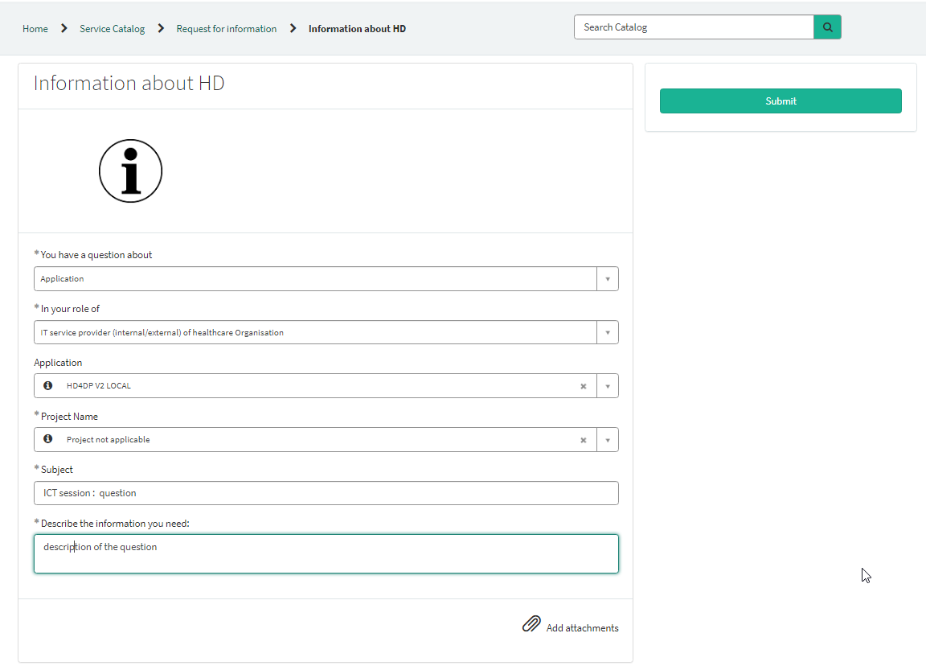
Contacting Healthdata Support
https://sciensano.service-now.com/sp
Self service portal
365 view
Subject – ICT Session: Question
onboarding.healthdata@sciensano

Slide 17
Updates & Communications
Topic | Message
Discrepancies in documentation / DCD specs | We regularly receive remarks that our documentation and/or DCD specifications contain a discrepancy in relation to the form or the feedback received from CSV or API transfer. We apologize for the inconvenience and delay this causes during the development of a data transfer. We are constantly working to improve the quality of documentation and DCD specifications and we truly appreciate your remarks. Most of the time, the remarks are very detailed, which helps us to analyse and correct the problem more efficiently.
Release Architecture 2.5 | The HD Release Management Board didn’t approve the release of Architecture 2.5 due to incomplete documentation and training of our support services. The release is schedule on next HD Release Management Board of Tuesday 26/10 (for a release on 2/10).
EAM 3.0 | Pilot testing couldn’t start due to additional discovered bugs during testing. A release on 2/10 will be discussed on next week HD Release Board.

Slide 18

Q & A

Slide 19








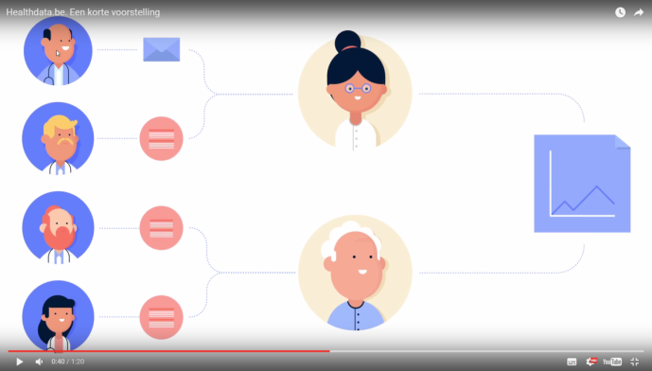
www.healthdata.be
healthdata@sciensano.be
Sponsored by
healthdata be
@healthdatabe

