Slide 1

ICT Info session
15 / 09 / 2023
This meeting is recorded for purposes of meeting minutes, delayed viewing by absentees, and internal (HD) operations. The recording will be stored internally, accessible by Sciensano employees, and temporarily by invitees.

Slide 2
Agenda
Q&A Backlog
HD4DP2 Metrics
Incidents Report
Updates & Communications

Slide 3
Q&a backlog

Slide 4
JSON
 | Question | Answer
Q1 | Regarding discharge date TX_TTL_DISCH_DATA: I can understand that you need the information if any CABG has been performed during the hospitalisation CD_CABG_EXEC, one response for the hospitalisation Then, repeatable. I can understand, even if that should not be very frequent, several CABG could take place during the hospitalisation DT_EXEC_CABG One date for each CABG during the hospitalisation I hope I’m not mistaken until now. Then, repeatable in repeatable for CD_BYP_RESTE_STENT, yes or no, TPE_CABG_EXEC, multiple values from list segmenten, multiple values from list It is unclear for me. I don’t understand which repeatable (and which multiple value from list) information is needed Could you describe me such a complex and multiple clinical situation and the JSON translating this situation ? | This is a rather complex question which has required some investigating. A new JSON file will soon be created to address the second part of your question. As for providing you with a description of the actual clinical situation, it would be advisable to reach out to the QERMID for further information.

Slide 5
HD4DP2 Metrics

Slide 6
HD4DP2 Metrics (as of 14/09 – compared with 08/09)
 | Metric | Count
 | Number of records received | Total : 58501 (+2882) - Manual 54239 (+2257) - CSV 1543 (+84) - API 2719 (+541)
 | User Accounts | Total : 7488 (+93)

Slide 7
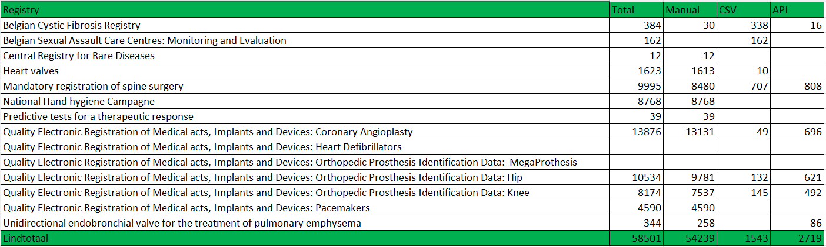
HD4DP2 Metrics (as of 14/09)

Slide 8
Incidents report

Slide 9
Total Open Incidents and Requests

Slide 10
Total Closed Incidents and Requests

Slide 11
Request Increase – Password Reset
  40 new requests
    25% of newly created tickets is password reset
    Arxus link
      5 click – 10 day
      In revision
      EAM 3.0 reset password function

Slide 12
Decrease Open Tickets
EAM 2.7 backlog
  50% - 70 tickets – 2 weeks
Additional resource
  Improvement intake and MTTR

Slide 13
Incidents and Requests per Project – not ‘closed’ state
Project | Count
 | 42
A Prospective Observational Registry to describe the disease course and outcomes of Idiopathic Pulmonary Fibrosis patients in a real-world clinical setting | 4
Belgian Cystic Fibrosis Registry | 27
Belgian HIV-AIDS Cohort Study | 4
Belgian Sexual Assault Care Centres: Monitoring and Evaluation | 3
Congenital Infections Registry | 1
Heart valves | 12
Mandatory registration of spine surgery | 16
National Hand hygiene Campagne | 6
National Surveillance Septicemia in Hospitals | 4
Predictive tests for a therapeutic response | 5
Publication and maintenance of a Service Level Agreement for the HD4DP2 web application of healthdata.be | 1
Quality Electronic Registration of Medical acts, Implants and Devices: Coronary Angioplasty | 24
Quality Electronic Registration of Medical acts, Implants and Devices: Orthopedic Prosthesis Identification Data v1 | 6
Quality Electronic Registration of Medical acts, Implants and Devices: Orthopedic Prosthesis Identification Data: MegaProthesis | 5
Quality Electronic Registration of Medical acts, Implants and Devices: Orthopedic Prosthesis Identification Data: Hip | 14
Quality Electronic Registration of Medical acts, Implants and Devices: Orthopedic Prosthesis Identification Data: Knee | 15
Quality Electronic Registration of Medical acts, Implants and Devices: Pacemakers | 26
Quality Electronic Registration of Medical acts, Implants and Devices: Pacemakers: Micra | 1
Registry Belgian Association for Cardio-Thoracic Surgery | 2
Registry Next-Generation-Sequencing tests for oncology | 1
Reimbursement of implantable meshes for the repair of prolapse, for vaginal placement | 1
Total | 220

Slide 14
Incidents per Project – TOP 3
BCFR
Pacemaker
Angio

Slide 15
Deep dive BCFR (only development tickets)

Slide 16
Updates & communications

Slide 17
Updates & Communications
Prioritization | Current priority focus of our development and operational teams are: - BCFR - HIV (arch1) - EAM 3.0 - Arch 2.5 - MyCareNet flow
Release Architecture 2.5 | No scheduled date for the architecture 2.5 release. Last testing was done this week resulting in documentation not being ready. It will be discussed again next week during the HD Release Management Board meeting. Architecture 2.5 is a major release containing fundamental changes which impact core functionality and process on the HD4DP2 platform. Not only new code value API and new CVS folder structure, but also many performance enhancements. Therefore, it was not possible to isolate the new code value API feature and let it work on architecture 2.0.
EAM 3.0 | On track. Last bug fixing and subsequent retesting conducted this week. Pilot testing with hospitals due to start next week.

Slide 18

Q & A

Slide 19








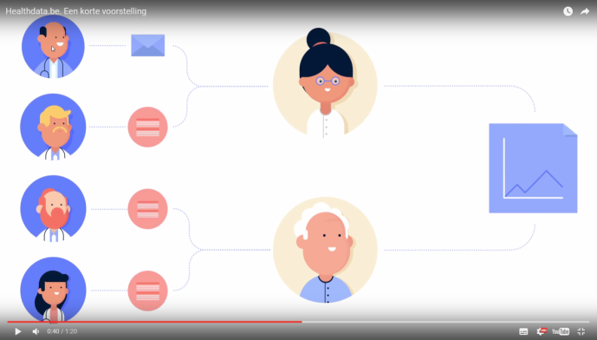
www.healthdata.be
healthdata@sciensano.be
Sponsored by
healthdata be
@healthdatabe

