Slide 1

ICT Info session September 8th, 2023
This meeting is recorded for purposes of meeting minutes, delayed viewing by absentees, and internal (HD) operations. The recording will be stored internally, accessible by Sciensano employees, and temporarily by invitees.

Slide 2
Agenda
Q&A
HD4DP2 Metrics
Incidents Report
EAM 3.0
Updates & Communications

Slide 3
Agenda
Q&A
HD4DP2 Metrics
Incidents Report
EAM 3.0
Updates & Communications

Slide 4
API
 | Question | Answer
Q1 | How will HD know if we are sending a code or an id (e.g. for postcodes, they look the same) ? | There will be 2 different API end point. The current end point expects MDM IDs → meaning nothing will change for the current API implementations. A new end point that expects code values.

Slide 5
Documentation
 | Question | Answer
Q2 | Data-collection-names are very important, however they are missing in documentation for several projects. Cf. RITM0013243 : already open for two months now | We apologize for the delay in resolving the ticket. The DCD specifications have been published onto DOCs last week on Friday.

Slide 6
CSV Upload
 | Question | Answer
Q3 | We will go live with several registries in St Luc couple We are going live with various registers in the coming weeks. We would like to receive an automated email notification whenever there is an error with any of our submissions. Is this something you could arrange? For instance, could you set up a system to send us an email whenever a file is created in the ERROR folder for Spine? The email should be directed to someone at Saint-Luc. Thank you. | This feature has been placed onto our roadmap from the moment this feature was suggested the first time some time ago. Unfortunately, we haven’t been able to plan the implementation due to other priorities and incidents. In the meantime, if this feature is of high importance to your organization and since there is full access to this folder by the IT department, it might be worth considering writing a local script to monitor the error folder.

Slide 7
Agenda
Q&A
HD4DP2 Metrics
Incidents Report
EAM 3.0
Updates & Communications

Slide 8
HD4DP2 Metrics (as of 8th Sept)
 | Metric | Count
 | Number of records received | Total - 55619 - Manual 51982 - CSV 1459 - API 2178
 | User Accounts | Total created - 7395

Slide 9
Agenda
Q&A
HD4DP2 Metrics
Incidents Report
EAM 3.0
Updates & Communications

Slide 10
Total open incidents and requests

Slide 11
Total closed incidents and requests

Slide 12
Decrease open tickets
EAM 2.7 backlog
50% - 90 tickets – 2 weeks
Additional recourse
Improvement intake and MTTR

Slide 13
Incidents and request per Project – not ‘closed’ state

Slide 14
Incidents per Project – TOP 3
BCFR
Pacemaker
Angio

Slide 15
Deep dive BCFR

Slide 16
Agenda
Q&A
HD4DP2 Metrics
Incidents Report
EAM 3.0
Updates & Communications

Slide 17
EAM 3.0: Update
Testing resumed
Week of 02/10: Planned deployment in production
Status:
- We are still waiting for our software vendor (Form.io) to be able to finalize EAM 3.0.
Impacted use case: the unique constraint of the author group name and the email address of the author.
Workaround: it is already implemented into EAM 3.0 that the author group name must be unique.
- Testing of the other features has been resumed.

Slide 18
Agenda
Q&A
HD4DP2 Metrics
Incidents Report
EAM 3.0
Updates & Communications

Slide 19
Updates & Communications
Release 2.5 | No new release date for the full 2.5 release yet, regression testing is still ongoing. But, focus is on the new API feature (code values) of the release. Last issues have been sorted out regarding the new API feature and we are now investigating if we can release only this API feature instead of the complete 2.5 release. This topic is on the agenda of our release board beginning next week.
MyCareNet (P12+Whitelisting) | For the hospitals who intend to go for option 2, we are still missing a number of P12 certificates. Among the hospitals who already have provided the P12, there is still whitelisting to take place https://prod.mycarenet.be:9443 https://services.ehealth.fgov.be A communication is scheduled to be sent relating to this topic in the near future.

Slide 20

Q & A

Slide 21








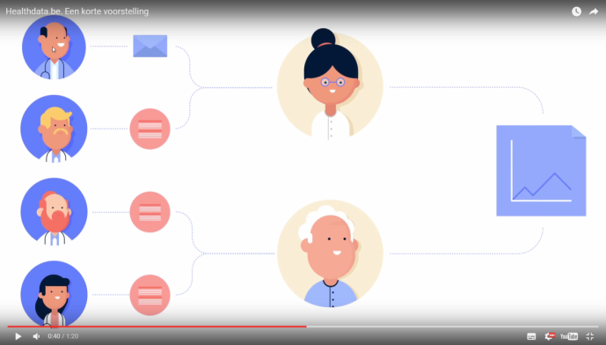
www.healthdata.be
healthdata@sciensano.be
Sponsored by
healthdata be
@healthdatabe

