Slide 1

IT Infosession August 4th, 2023
This meeting is recorded for purposes of meeting minutes, delayed viewing by absentees, and internal (HD) operations. The recording will be stored internally, accessible by Sciensano employees, and temporarily by invitees.

Slide 2
Agenda
Q&A of questions received
Incident and Request metrics
Varia

Slide 3
Feature request
 | Question | Answer
Q01 | We are going live with various registers in the coming weeks. We would like to receive an automated email notification whenever there is an error with any of our submissions. Is this something you could arrange? For instance, could you set up a system to send us an email whenever a file is created in the ERROR folder for Spine? The email should be directed to someone at Saint-Luc. | Thank you for this feature request. This is certainly something that we are willing to investigate. Feedback / proposal will be presented in a weekly ICT meeting. If this proposal is acceptable for HCO’s, we can schedule it in our planning.

Slide 4
PITTER
 | Question | Answer
Q02 | How about the Pitter register is it available on acc, asked ServiceDesk but still no response. PITTER goes live 01/09 (with MyCarenet connector). For testing a thought we had 2 months for testing before production ? | A ticket was created to deploy PITTER on the online HD4DP acceptance environment: target date 8/8/2023. The contact points for PITTER registrations will be informed concerning the availability of the Pitter registrations in this acceptance environment.

Slide 5
CSV/API registrations
 | Question | Answer
Q03 | I have been working on the pacemaker / heart valves registers for several months, and we can now generate the necessary csv files for implantation / followups. I have never been able to submit a file with success, there are bugs that I have reported to the team. How can we be sure that it will be possible by the deadline of 31/08/2023? | Below are the open incidents:
DESCRIPTION | Information
[Pacemakers - Primo Implantation][Angio : Hospitalisation with PCI][CSV Upload] CSV Upload DRAFT cannot submit in GUI | Dev ongoing - ETA 08/08
[TAVI][Surgical] java.lang.RuntimeException: Error while getting MDM code content for field with name: CD_STE_AORTCVL id: 2224, code: 0 | Fixed and tested - production rollout 07/08
[TAVI][Surgical] "Significante disfunctie behandelde klep" fields empty after CSV upload | Fixed and tested - production rollout 07/08
[Pacemakers][GUI] "stimulatiemodus" fields uploaded through CSV, not showing in GUI | Fixed and tested - production rollout 07/08
TAVI][error MDM id 1953 and code 248153007 | Analysis ongoing - ETA TBD

Slide 6
CSV/API registrations
Q04 | Have you received successful angio or orthopride submission through API? If yes, could you provide a written document for the procedure please? | Yes, we have received data for angio ànd orthopride via API. In next slides we provide an overview of projects for which we received csv or api data. The api documentation for each project is available on https:docs.healthdata.be . Select project ➔ select “The [[project name]] data collection” ➔ select “HD4DP v2 S2S API”

Slide 7
Number of HCO that provided HD data, by project and by method
project | hd4dp2_records_manual | hd4dp2_records_csv | hd4dp2_records_api
Mandatory registration of spine surgery | 50 | 3 | 1
National Hand hygiene Campaign | 53
Quality Electronic Registration of Medical acts, Implants and Devices: Coronary Angioplasty | 39 | 1 | 1
Heart valves | 17
Quality Electronic Registration of Medical acts, Implants and Devices: Orthopedic Prosthesis Identification Data: Hip | 59 | 1 | 3
Quality Electronic Registration of Medical acts, Implants and Devices: Orthopedic Prosthesis Identification Data: Knee | 57 | 2 | 3
Quality Electronic Registration of Medical acts, Implants and Devices: Pacemakers | 60
Real world data collection on the efficacy and drug usage of Raxone 150 mg 180 film-coated tablets for treatment of reduced vision in adolescent and adult patients with Leber’s hereditary optic neuropathy | 5
Unidirectional endobronchial valve for the treatment of pulmonary emphysema | 6 |  | 1
Belgian Cystic Fibrosis Registry | 4 | 3 | 1
Central Registry for Rare Diseases | 1

Slide 8
Mandatory registration of spine surgery
HCO that provided data via csv or api
HCO | hd4dp2_records_csv | hd4dp2_records_api
AZ DELTA MENEN | X
CHU DE LIEGE SART-TILMAN | X
CLINIQUES UNIVERSITAIRES SAINT-LUC (UCL) | X
UZ LEUVEN GASTHUISBERG |  | X

Slide 9
Quality Electronic Registration of Medical acts, Implants and Devices: Coronary Angioplasty
HCO that provided data via csv or api
HCO | hd4dp2_records_csv | hd4dp2_records_api
UNIVERSITAIR ZIEKENHUIS GENT | x
UZ LEUVEN GASTHUISBERG |  | x

Slide 10
Quality Electronic Registration of Medical acts, Implants and Devices: Orthopedic Prosthesis Identification Data: Hip
HCO that provided data via csv or api
HCO | hd4dp2_records_csv | hd4dp2_records_api
AZ DELTA MENEN | x
AZ DIEST STATIESTRAAT |  | X
AZ GROENINGE KENNEDYLAAN |  | X
UZ LEUVEN GASTHUISBERG |  | x

Slide 11
Quality Electronic Registration of Medical acts, Implants and Devices: Orthopedic Prosthesis Identification Data: Knee
HCO that provided data via csv or api
HCO | hd4dp2_records_csv | hd4dp2_records_api
AZ DELTA MENEN | x
AZ DIEST STATIESTRAAT |  | x
AZ GROENINGE KENNEDYLAAN |  | x
AZ OUDENAARDE | x
UZ LEUVEN GASTHUISBERG |  | x

Slide 12
Unidirectional endobronchial valve for the treatment of pulmonary emphysema
HCO that provided data via csv or api
HCO | hd4dp2_records_csv | hd4dp2_records_api
UZ LEUVEN GASTHUISBERG |  | x

Slide 13
Belgian Cystic Fibrosis Registry
HCO that provided data via csv or api
HCO | hd4dp2_records_csv | hd4dp2_records_api
GROUPE SANTE CHC CLINIQUE CHC MONTLEGIA | x
HOPITAL ERASME (ULB) ERASME | x
HOPITAL UNIVERSITAIRE DES ENFANTS REINE FABIOLA (HUDERF) | x
UZ LEUVEN GASTHUISBERG |  | x

Slide 14
Incident and Request metrics

Slide 15
Total number of incidents registered in 2023, by week – HDI00069

Slide 16
Total cumulative number of incidents registered in 2023, by status and week – HDI00076

Slide 17
Incident Reaction Time (%) via service portal by healthdata.be, by week (2023) – HDI00056

Slide 18
Incident Resolution Time (%) of medium priority incidents (P4) by healthdata.be, by week (2023) – HDI00061
P4: 5 working days

Slide 19
Incident Resolution Time (%) of low priority incidents (P16) by healthdata.be, by week (2023) – HDI00062
P16: 10 working days

Slide 20
Total number of requests registered in 2023, by week – HDI00086

Slide 21
Total cumulative number of requests registered in 2023, by status and week – HDI00093

Slide 22
Request Reaction Time (%) via service portal by healthdata.be, by week (2023) – HDI00066

Slide 23
Average Request Resolution Time (hh:mm) by healthdata.be, by week (2023) – HDI00099
//

Slide 24
Varia

Slide 25
EAM 3.0: Planning
No changes
16/08:
End-2-end testing and fixing
Documentation finalized
Whitelisting finalized
Start testing with pilot organisation
21/08: Start training and demo for access managers
31/08: GO/NOGO
04/09: If GO: Deployment in production

Slide 26
Contacting healthdata.be
Healthdata.be prioritizes incidents and requests via ServiceNow portal
Incidents and requests via email are processed with lower speed.
Do not use “info@sciensano.be”. This is the main email address of Sciensano. Takes even more time before it arrives at healthdata.be.
Blocked emails:
Healthdata.be was informed that some organisations cannot send emails towards healthdata.be anymore
Email addresses of healthdata.be staff are managed by ICT department of Sciensano.
ICT department of Sciensano follows to “Sender Alignment” security requirements

Slide 27
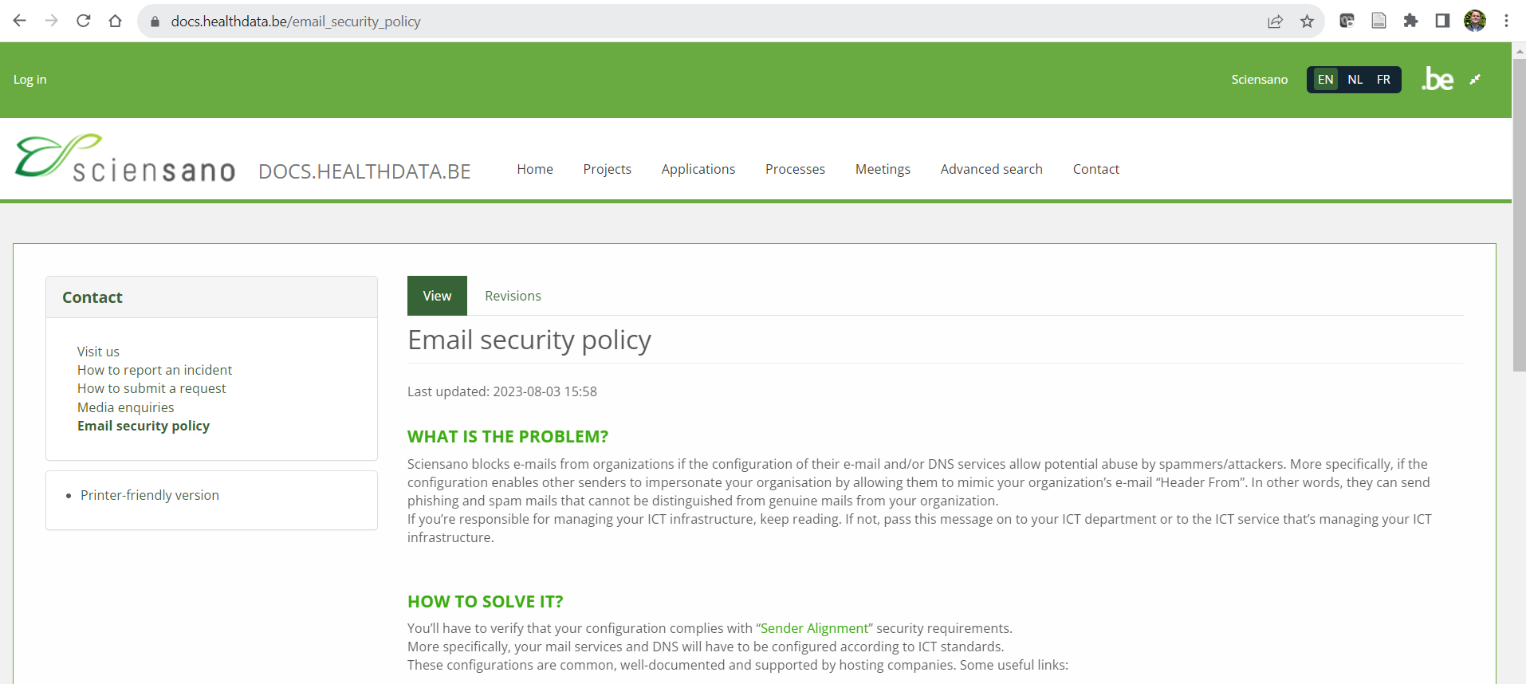
“Sender Alignment” security requirements
https://docs.healthdata.be/email_security_policy

Slide 28
Don’t forget
All the required information can be found on docs.healthdata.be page….

