Slide 1

IT Infosession
28th July 2023
This meeting is recorded for purposes of meeting minutes, delayed viewing by absentees, and internal (HD) operations. The recording will be stored internally, accessible by Sciensano employees, and temporarily by invitees.

Slide 2
Agenda
Q&A of questions received
Update of the next steps of EAM3.0
Communication from RIZIV/INAMI regarding end of transition period
Notes:
Q&A of questions received in the onboarding mailbox and unanswered questions during previous ICT information session.
Update of the next steps of the EAM 3.0.
Communication from Riziv/Inami regarding end of transition period.

Slide 3
EAM/Service Portal / Accounts
 | Question | Answer
Q01 | Could you tell us when the new EAM portal will be available. | That will be 04/09/2023. More details will be covered in next topic.
Q02 | Is a Request the perfect reflection of an account? How can I see the actual status of an account, can I trust this "Requests overview" tab (EAM UI) ? In other words, do request and account share the same Database table (or a system of perfect replication in real time) ? I mean if I ask for a change based on the "Requests overview" tab (EAM UI), does it have an impact on the associated account ? (RITM0013319) | In current EAM version: Indeed, the “request registrations” are not similar to the “account creations”. The EAM database is a central database (at HD) that collects all account requests. Based on the requests, the accounts are created locally, by HD. Currently the access manager can only see the status of the request (submission) and do not have access to the list of actual created accounts. At HD we collect the local lists of created accounts to support our technical teams to solve incidents. In EAM version 3.0 it is foreseen that the list of actual accounts and rights will also be available for the access managers.

Slide 4
DCD/technical documentation
 | Question | Answer
Q03 | Regarding the DCD files for Qermid Orthopride registres, would you be able to provide the code lists for CEMENT_NAME_81 and CEMENT_NAME_83? This question was previousy discussed during the meeting of July 7th, 2023. The two fields mentioned were not included in the DCD, but were to be added shortly. What is the current status? | The code lists have been adapted in the respective DCDs on the FAIR portal, and can be reached via the links on the relevant DOCs pages.
Q04 | We need the data collection names of the Angio and coronary valves, as used in the local database of the HD4DPv2 server. They should be available on the respective DOCS pages, but they are missing. (RITM0013243) | This request was in our back-log and is now assigned to the proper team and planned to be completed during the current sprint.

Slide 5
Mycarenet
 | Question | Answer
Q05 | Regarding the MyCareNet messages, is it possible to give us an indication of when these messages will be available. This will allow us to inform our financial department. | We are still in a test phase with MyCareNet and the insurance companies. As soon we have completed the test phase, we will communicate you accordingly (04.09.2023).

Slide 6
Update of the next steps of EAM3.0

Slide 7



EAM Basic flow
Healthcare organisation
❶ Navigate to eam.healthdata.be
healthdata.be
web
eam.healthdata.be
HD Integration
HD DWH
Integration engine (NextGen Connect)
Data validation (incl. Validation requests)
eHealth
Data Storage
TTP service
Data exploitation
HD4DP v2 local
HD4RES 2
Healthstat.be,
FAIR.healthdata.be
HCO system
HCO UM/EM
HD UM/EM
HD APPS
HD Master Data Management
Service Portal
EAM

Slide 8
EAM Basic flow
Healthcare organisation
❷ Access request (by Access Manager)
healthdata.be
eam.healthdata.be
HD Integration
HD DWH
Integration engine (NextGen Connect)
Data validation (incl. Validation requests)
eHealth
Data Storage
TTP service
Data exploitation
HD4DP v2 local
HD4RES 2
Healthstat.be,
FAIR.healthdata.be
HCO system
HCO UM/EM
HD UM/EM
HD APPS
HD Master Data Management
Service Portal
EAM
Notes:
First an overview of the EAM Basic Flow.
In this example, the scenario where an access manager is making the EAM request is taken as base.
Using any browser, the access manager navigates to the EAM online application which is hosted at healthdata.be. He creates an EAM request (account or grant). The request is stored at the centralised EAM database hosted at healthdata.be
The EAM request (grant) is processed and is executed on the HD4DP2 installation for which the grant has been requested. The actual grants are stored on the local HD4DP2 platform.
Important note: There is a difference between the request and actual account/grant. They are stored in different databases.

Slide 9
EAM Basic flow
Healthcare organisation
healthdata.be
eam.healthdata.be
HD Integration
HD DWH
Integration engine (NextGen Connect)
Data validation (incl. Validation requests)
eHealth
Data Storage
TTP service
Data exploitation
HD4DP v2 local
HD4RES 2
web
Healthstat.be,
FAIR.healthdata.be
HCO system
HCO UM/EM
HD UM/EM
HD APPS
HD Master Data Management
Service Portal
EAM
❸ Creation of Access
Notes:
First an overview of the EAM Basic Flow.
In this example, the scenario where an access manager is making the EAM request is taken as base.
Using any browser, the access manager navigates to the EAM online application which is hosted at healthdata.be. He creates an EAM request (account or grant). The request is stored at the centralised EAM database hosted at healthdata.be
The EAM request (grant) is processed and is executed on the HD4DP2 installation for which the grant has been requested. The actual grants are stored on the local HD4DP2 platform.
Important note: There is a difference between the request and actual account/grant. They are stored in different databases.

Slide 10
EAM 2.6 vs EAM 3.0
EAM 2.6 (current)
EAM 3.0 (September 2023)
Processing of EAM requests:
→ Using ansible script pushed towards HD4DP2 installations via daily updater process
Processing of EAM requests:
Using Azure message bus technology
New functionalities
Better follow-up on request status
Overview on granted access within organisation
Better management by local access manager:
  Password reset
  Change of author group
  Change of role
  Disabling rights

Slide 11
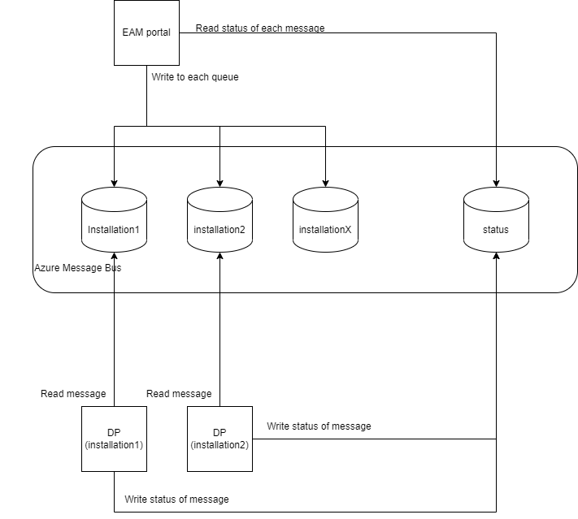
EAM 3.0: SERVICE BUS
WHY
EAM 1.x and 2.x → system to manage access requests
No feedback loop between EAM / DP installations
Ansible not fit for purpose for User management at DP side.
BENEFITS
Provides feedback loop
Faster User Onboarding
Better User Experience
Less manual intervention needed by Support / DevOps
Notes:
The message bus will hold a queue per organisation. The central EAM application and the local HD4DP2 installation communicate with each other via messages in the different queues.

Slide 12
EAM 3.0: SERVICE BUS – Whitelisting needed
For the HD4DP2 platform to be able to communicate with the Message Bus, a specific url will need to be whitelisted on your network.
You will be contacted by our onboarding team with instructions.
Target date for all organisation to be have whitelisted the url: 16/08
Follow-up will be done by our onboarding team.

Slide 13
EAM 3.0: Planning
Why postponed (again)?
Substantial changes in backend and frontend
Testing by test team (HD support desk) revealed minor bugs and possible improvements for user friendliness.
No go live with application that was not 100%. Purpose is reduction of number of tickets, not an increase.
Taking into account the holiday period.

Slide 14
EAM 3.0: Planning
New planning
16/08:
End-2-end testing and fixing
Documentation finalized
Whitelisting finalized
Start testing with pilot organisation
21/08: Start training and demo for access managers
31/08: GO/NOGO
04/09: If GO: Deployment in production

Slide 15
Communication
by RIZIV/INAMI

Slide 16
End of transition period - RIZIV/INAMI
Communication RIZIV/INAMI:
In agreement with the hospital federations, the transitional regulations will end on 31/08/2023
From 01/09/2023 the obligation to register before invoicing will apply
All implantations from the start of the register in Architecture 2 at healthdata.be until 31/08/2023 related to Spine Surgery, Orthopride, Pacemakers, Coronary Angioplasty and Heart Valves must be retroactively registered in the relevant register by 01/01/2024. Healthdata.be will support this process (detailed information next session).
This information is also available on the RIZIV/INAMI website with this link

Slide 17
Don’t forget
All the required information can be found on docs.healthdata.be page….

